Slide 1
GOODMAN ONE
Assembly guide

Slide 2
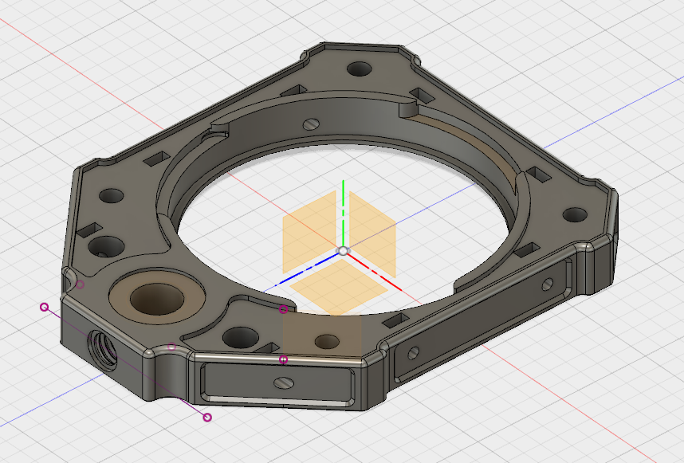
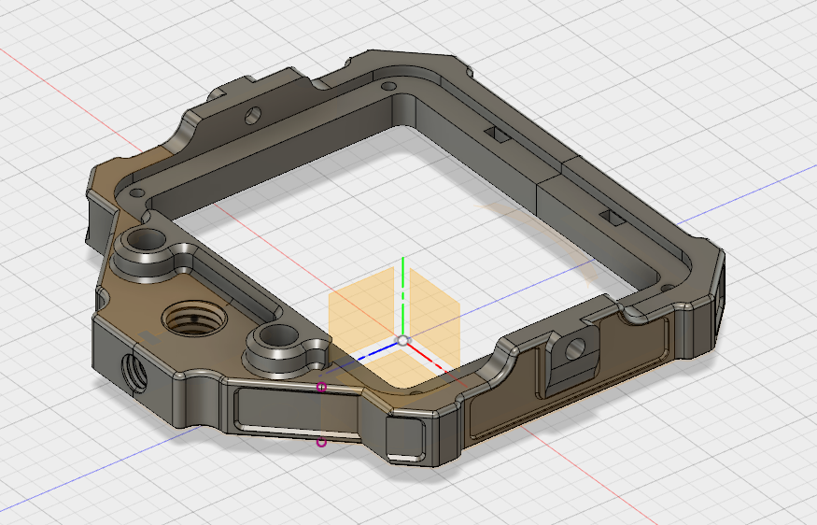
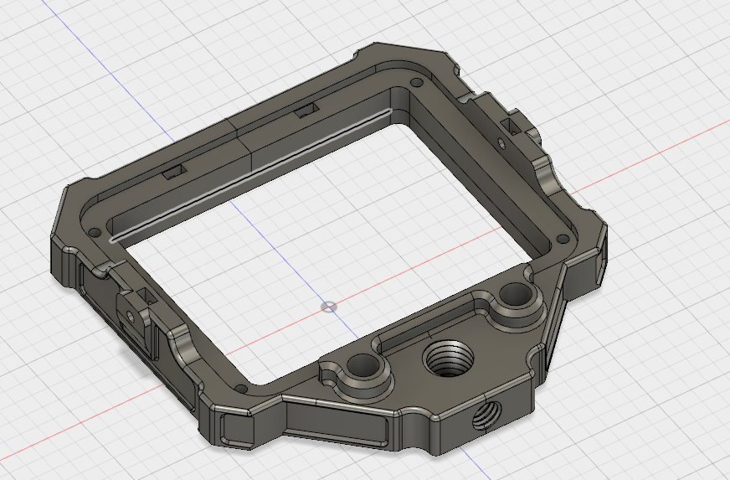
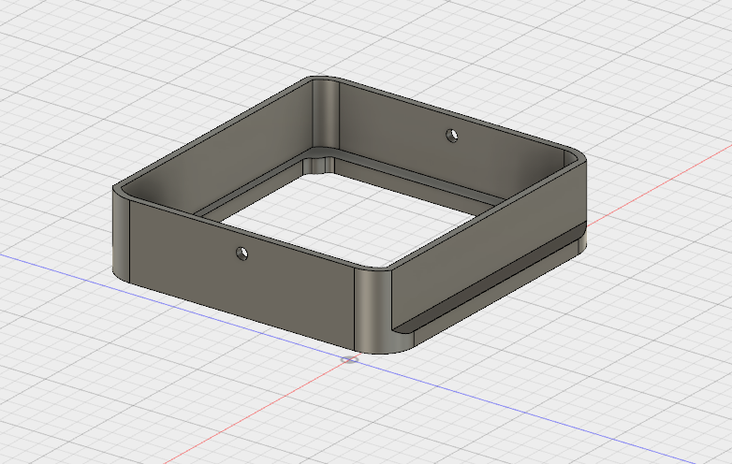
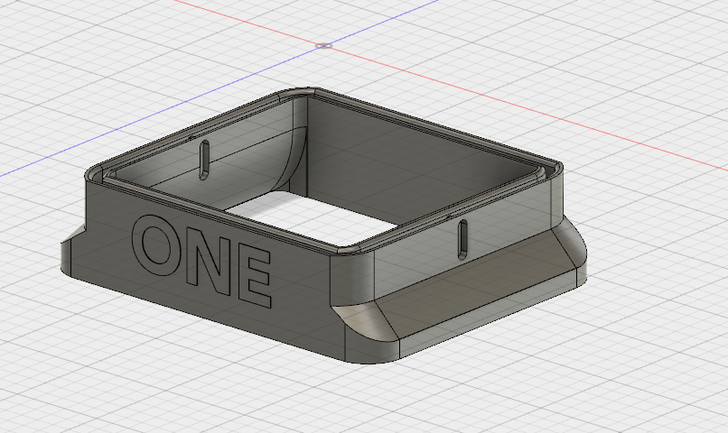
THE PRINTED PARTS
Front (universal)
Back (brass version)
Back (M3 version)
“Bellow” male
“Bellow” female

Slide 3
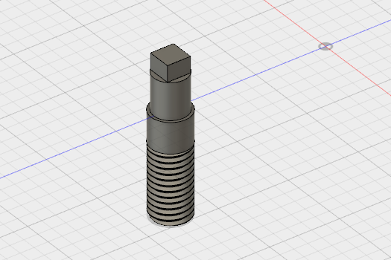
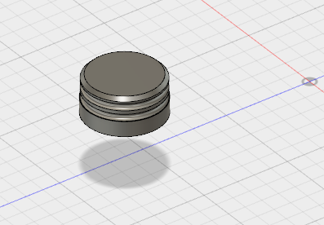
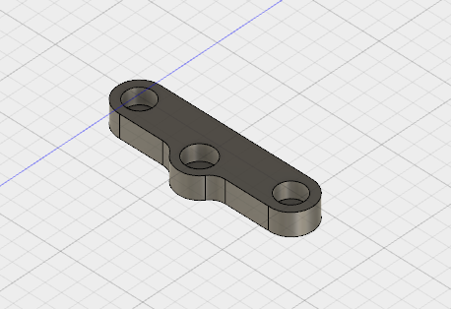
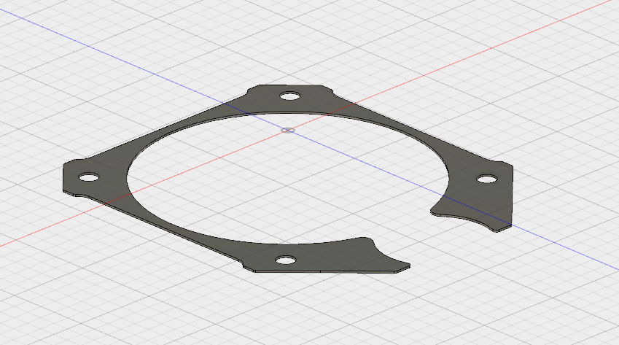
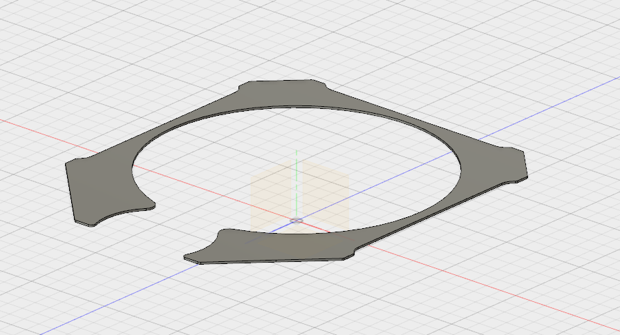
THE PRINTED PARTS
Thread
Knob
Rail cover
Front cover ( brass version )
Front cover ( M3 version )

Slide 4
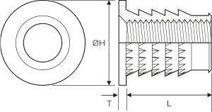
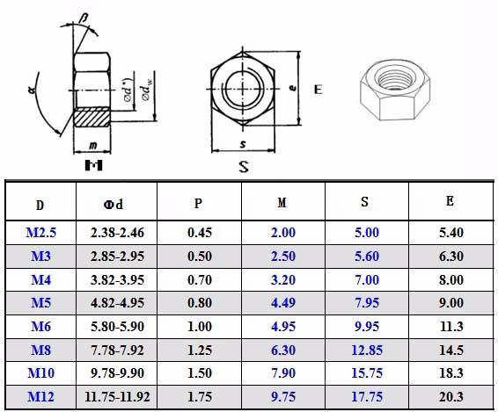
WHAT YOU NEED TO GET
BRASS VERSION ONLY
BRASS THREADED INSERT - 6PCS
M4 / 0H - 9mm / T - 1mm / L - 5mm
2.
M3 NUT - approx. 20PCS

Slide 5
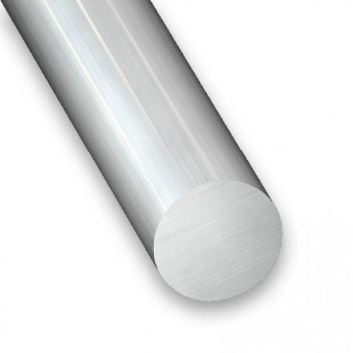
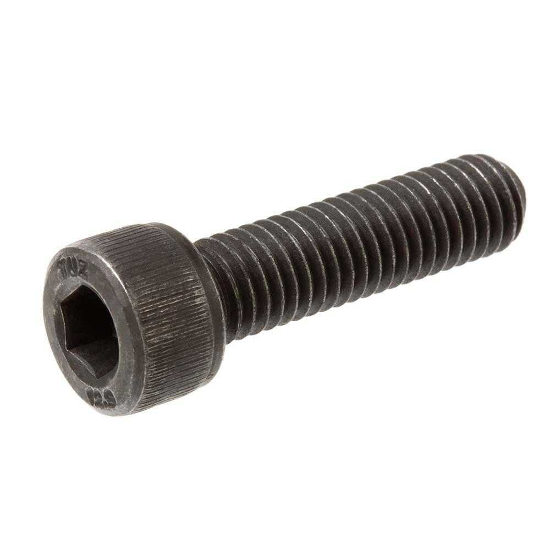
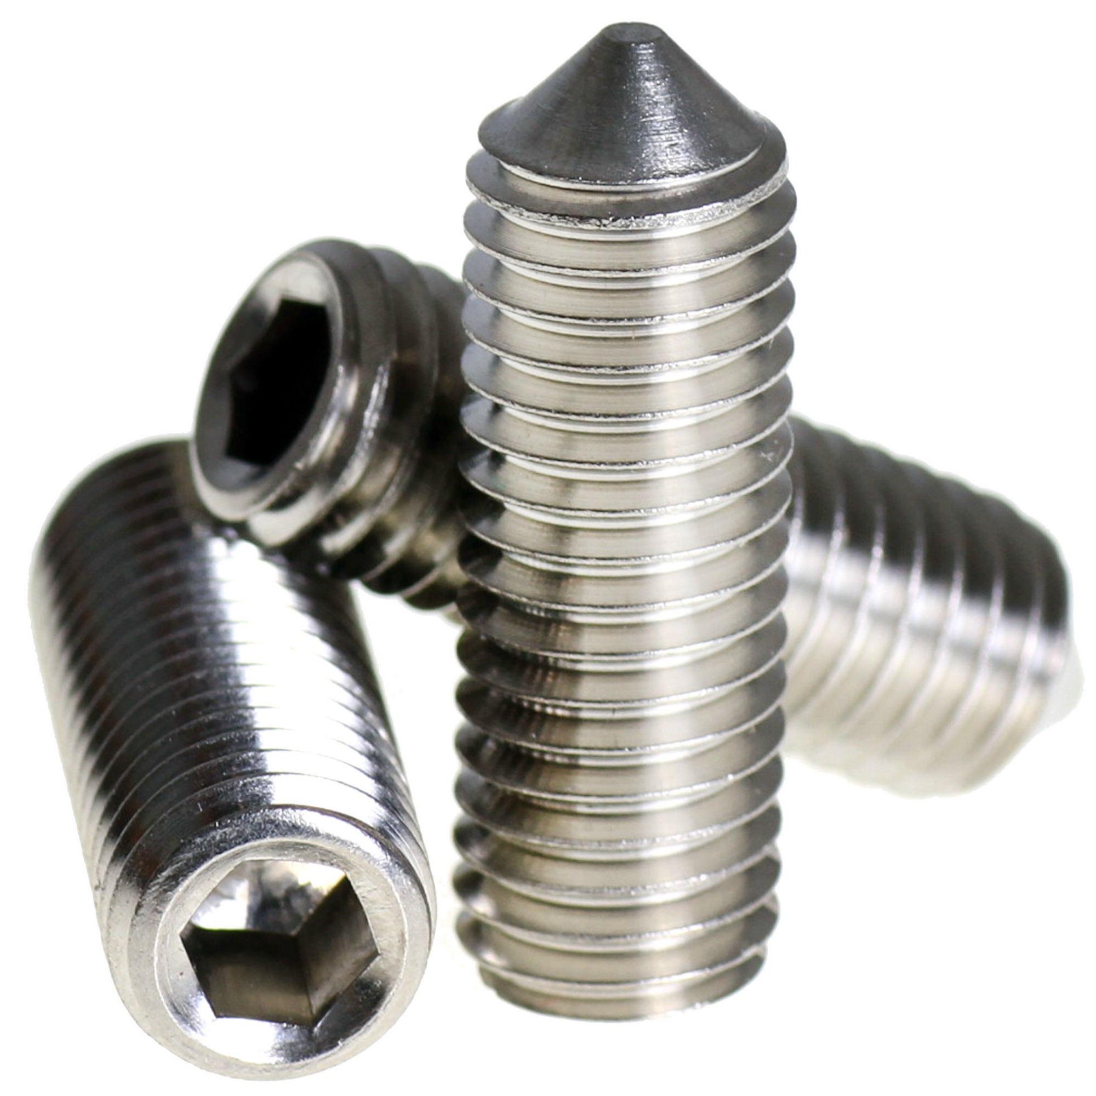
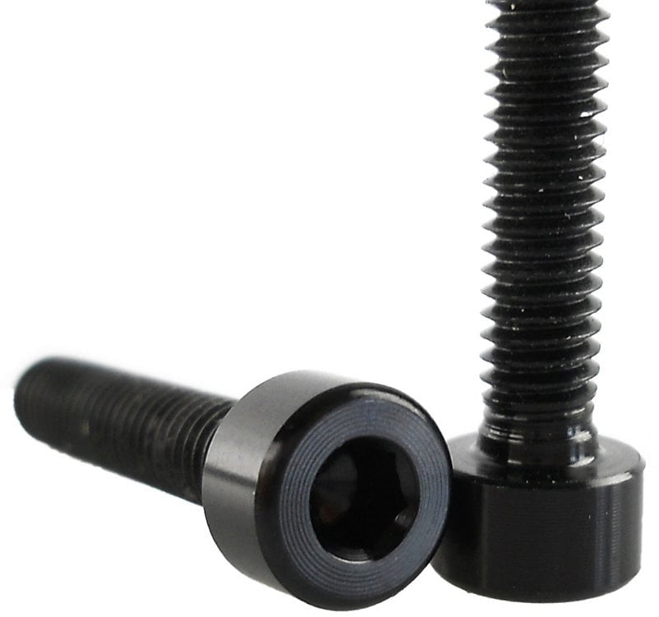
WHAT YOU NEED TO GET
3.
5.
8mm ROD - 2PCS
Min. 50mm / piece
M3 SCREW
Various length from 10mm to 14mm
Min. 12PCS each
4.
6. BRASS VERSION ONLY
M3 SET SCREW
8mm - min. 6PCS
6mm - min. 6PCS
M4 SCREW
For the brass inserts

Slide 6
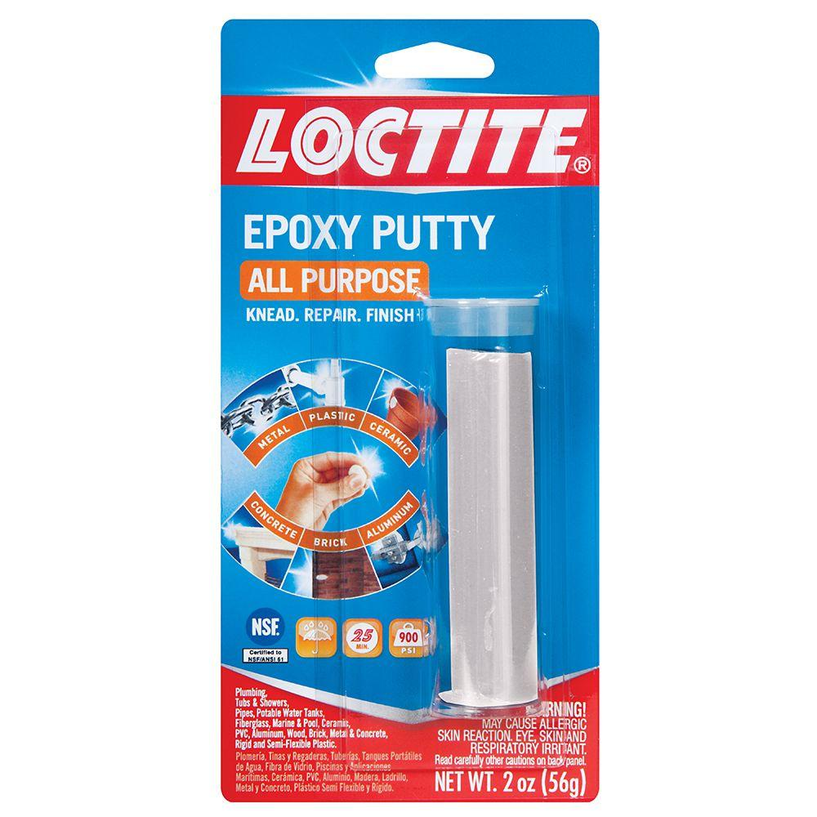
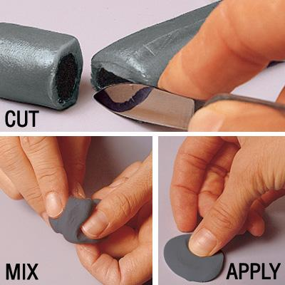
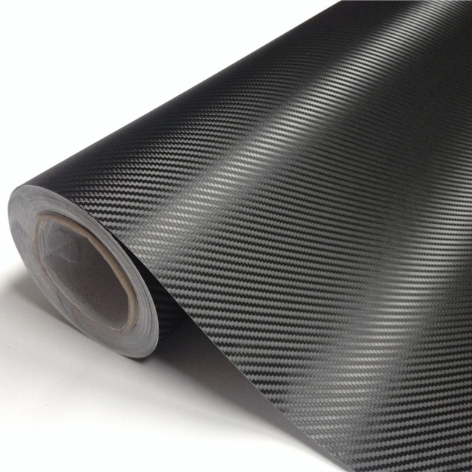
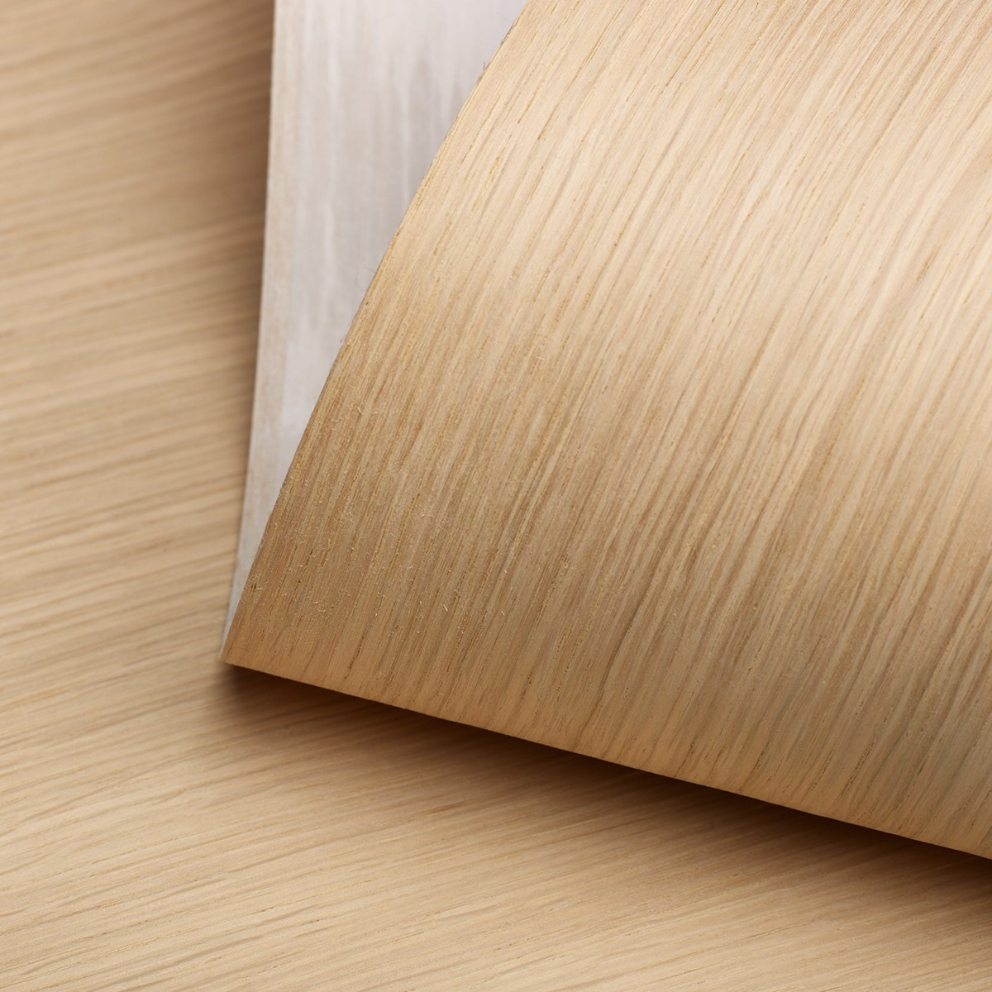
WHAT YOU NEED TO GET
7.
EPOXY PUTTY
8.
DECOR FOIL OR WOODEN VENEER

Slide 7
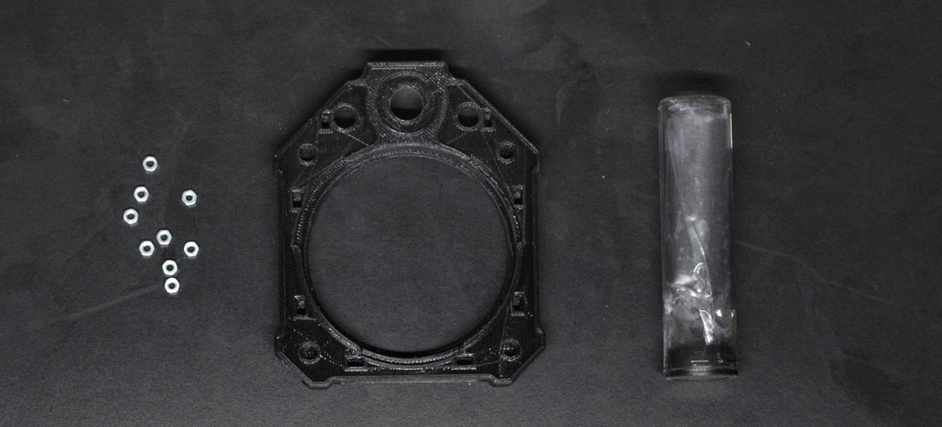
M3 NUTS INTO THE PRINT
You will need the front and the back printed part, M3 nuts and the epoxy putty

Slide 8
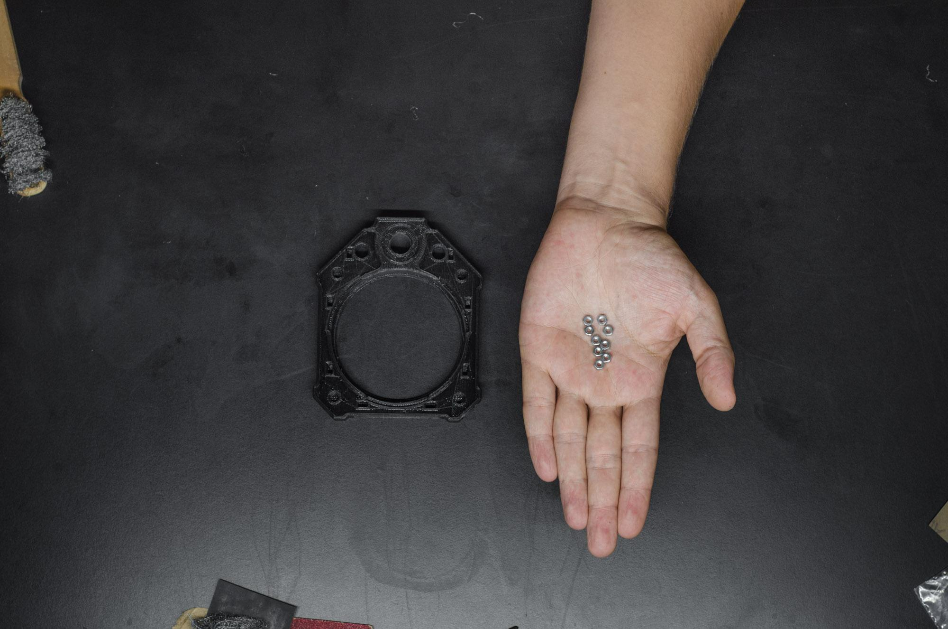
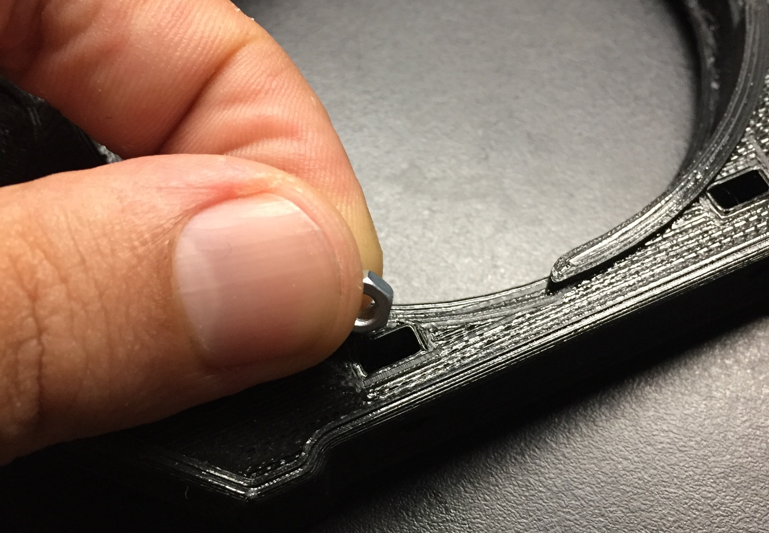
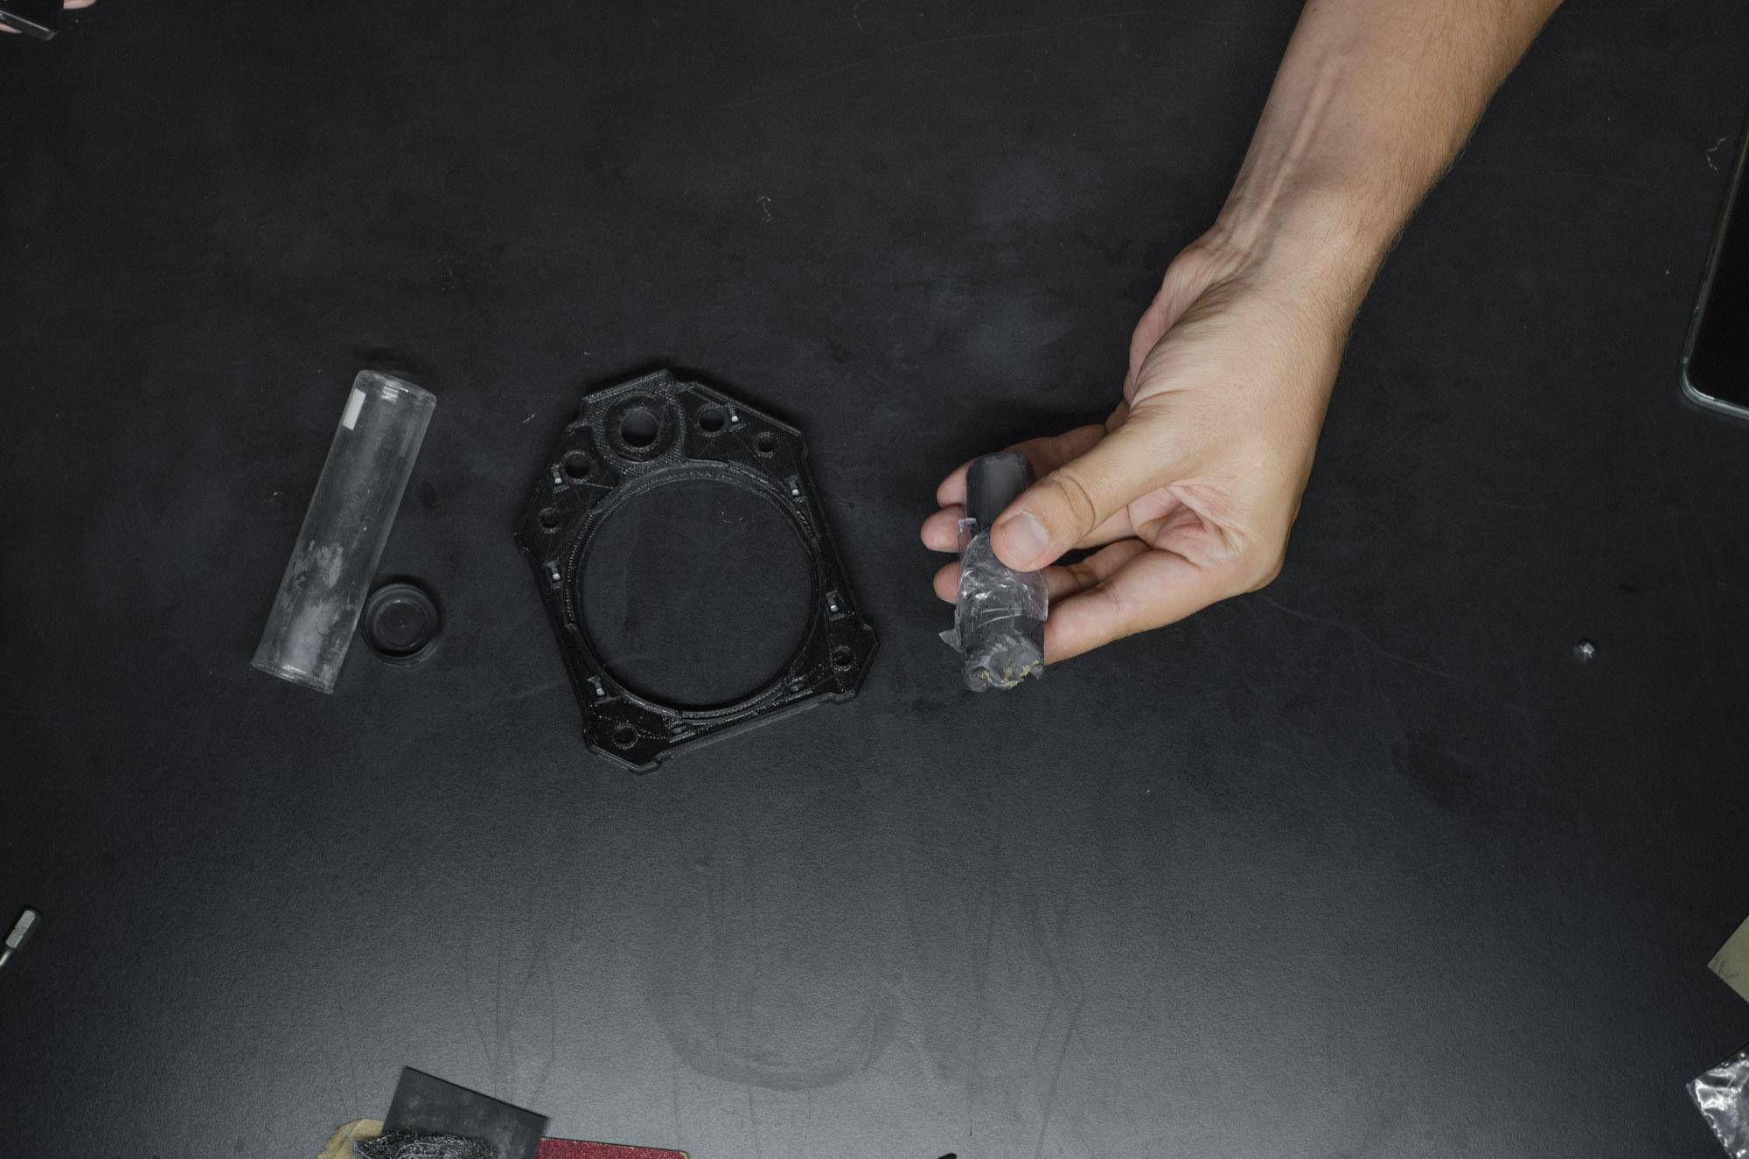
M3 NUTS INTO THE PRINT
Put the nuts into the rectangle shaped holes of the FRONT and BACK printed piece. Make sure all of the nuts reach the bottom of the holes.
(there are 2 holes on the GOODMAN ONE BRASS versions BACK piece and 4 on the M3 back)

Slide 9
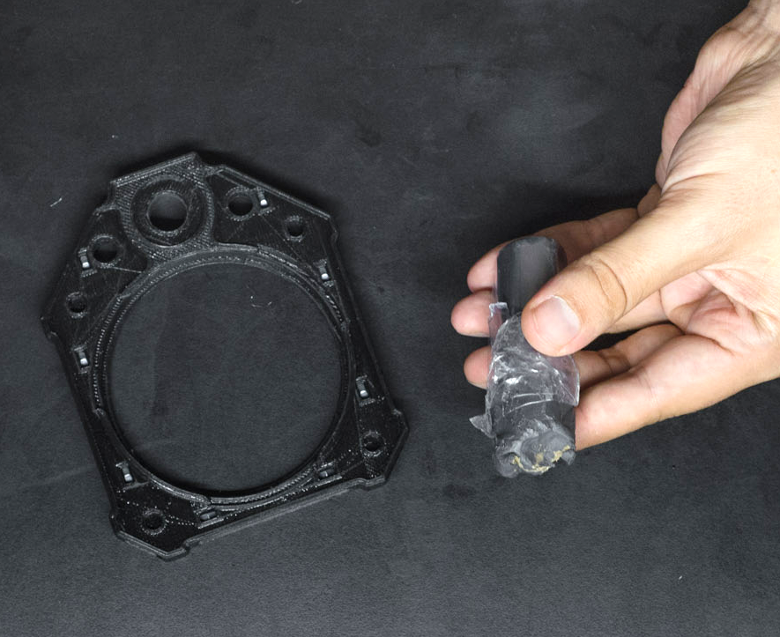
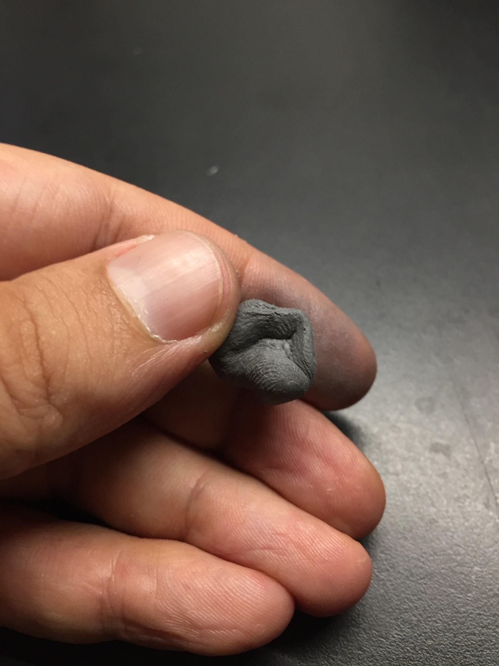
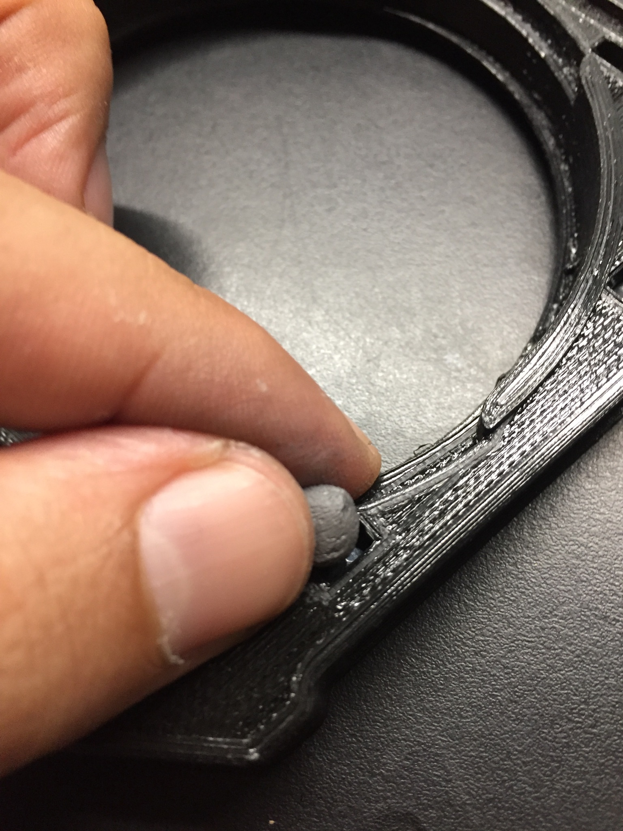
FIX THE NUTS WITH EPOXY PUTTY
Mix the two component of the epoxy and put a small amount in every hole with a nut in it

Slide 10
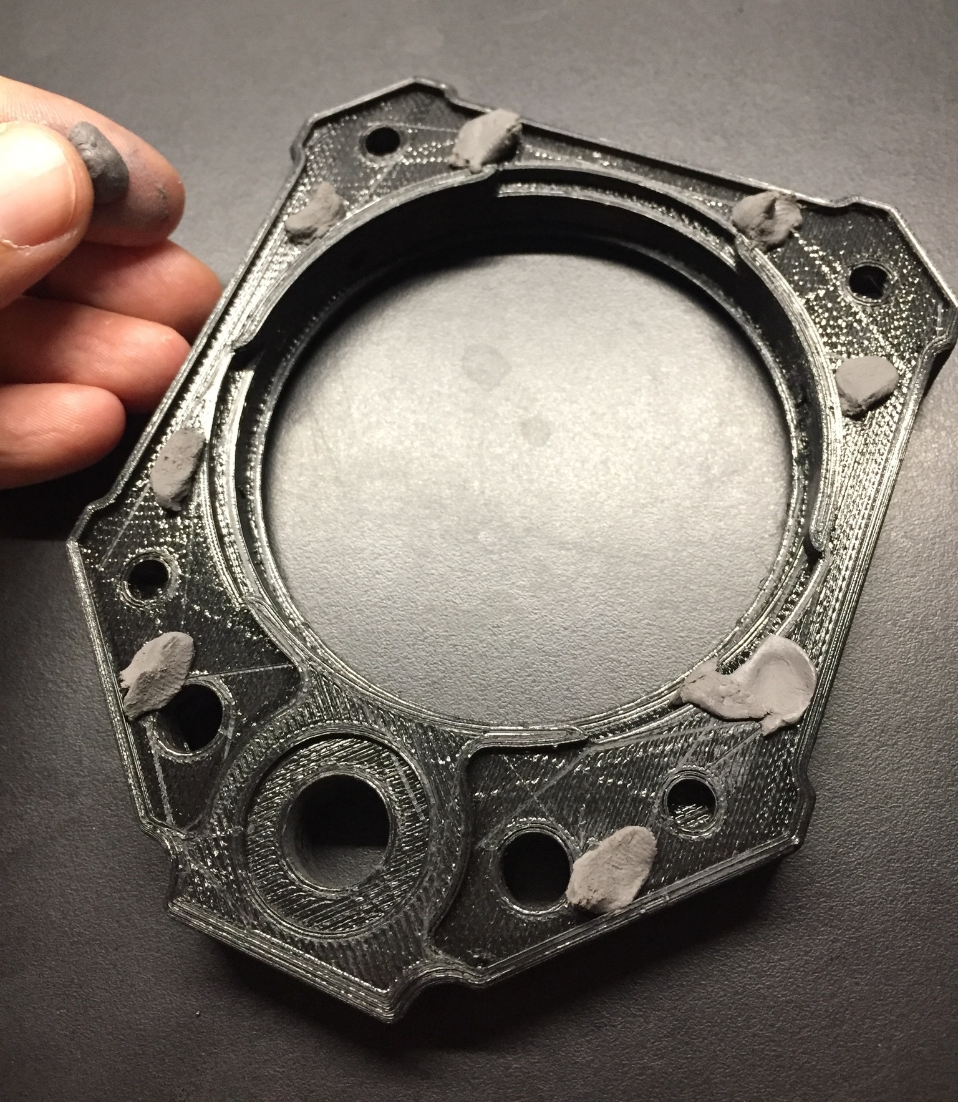
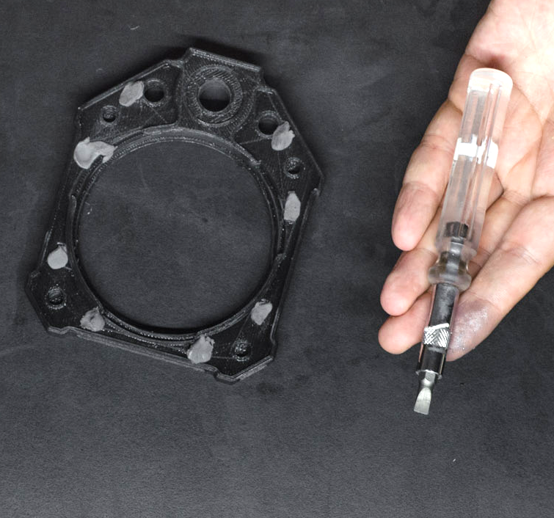
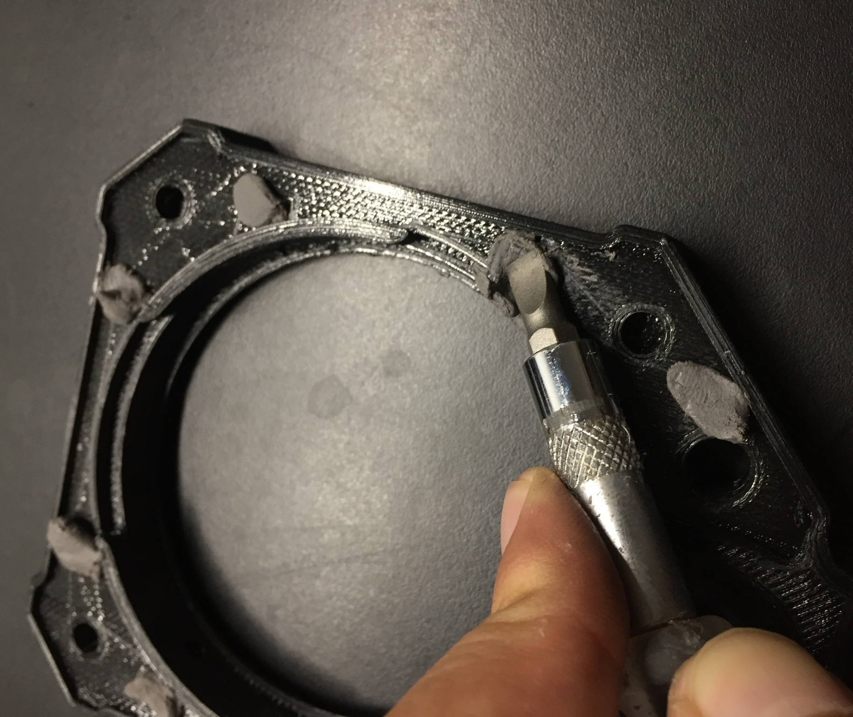
FIX THE NUTS WITH EPOXY PUTTY
Compress the epoxy deep in the holes with the edge of a regular screwdriver and then get rid of the left-overs before it cures.

Slide 11
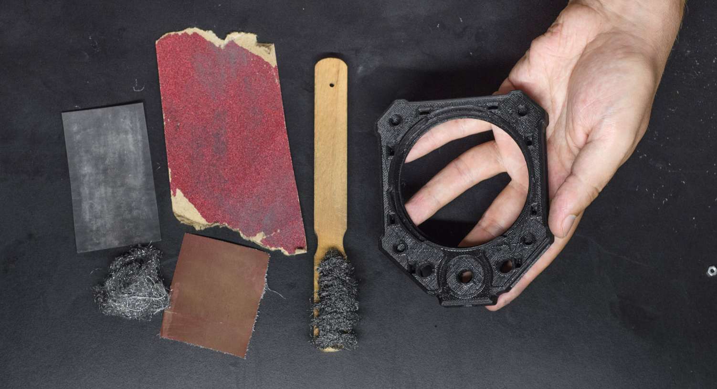
CLEANING AND SANDING

Slide 12
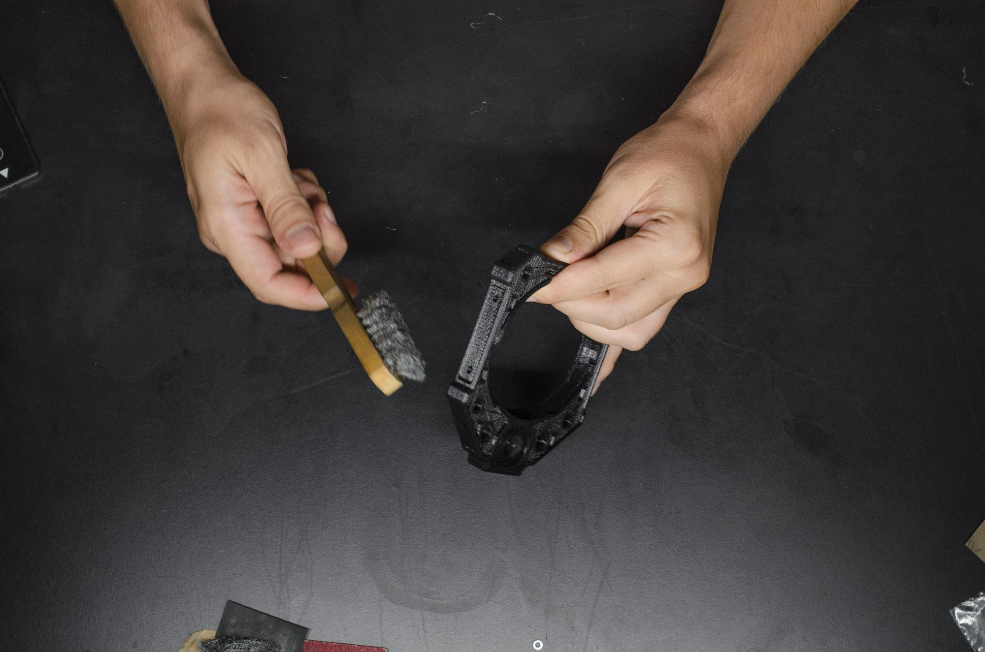
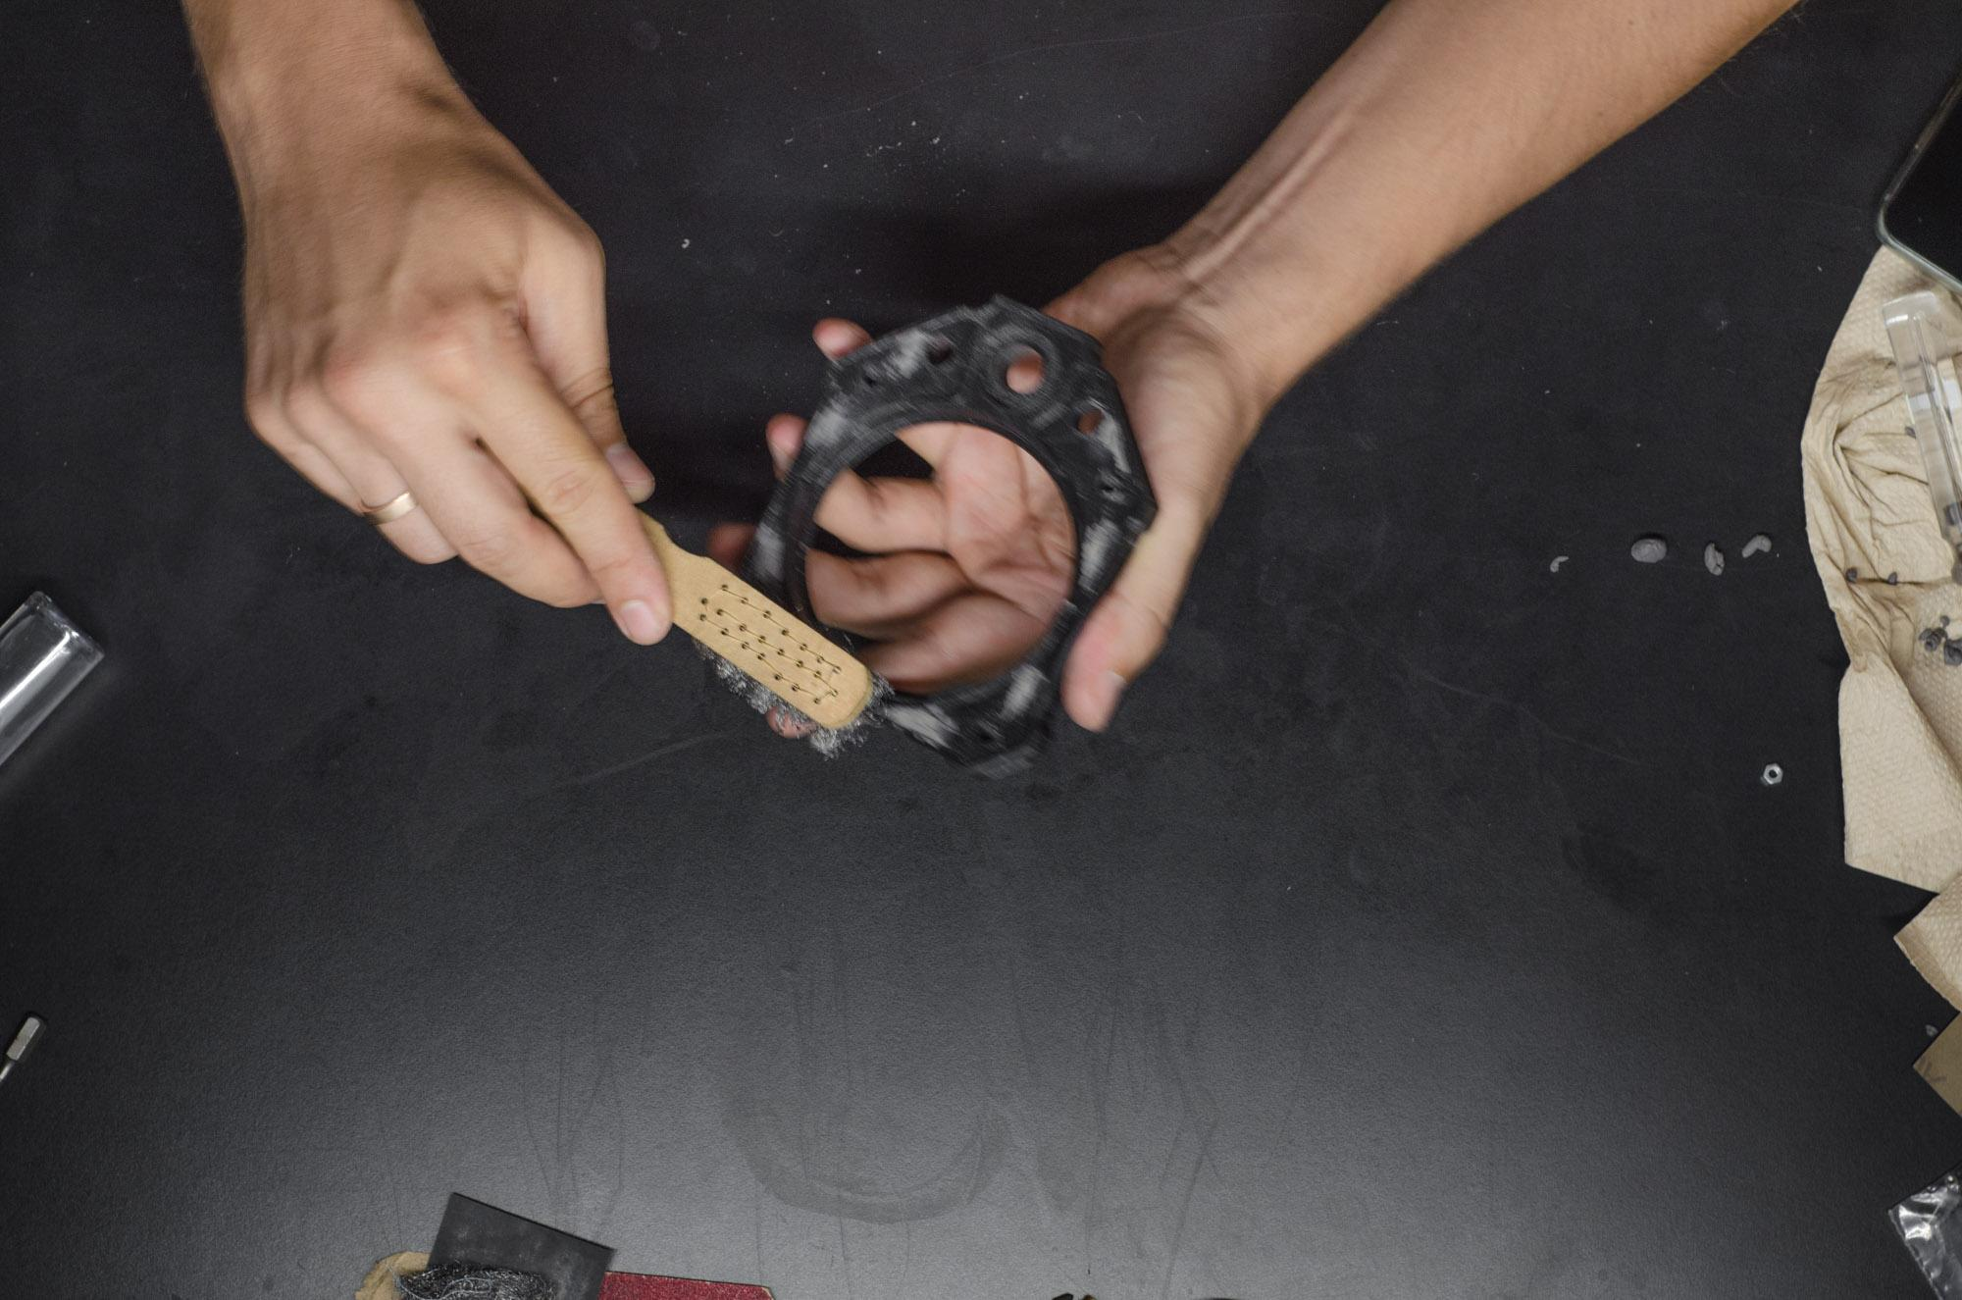
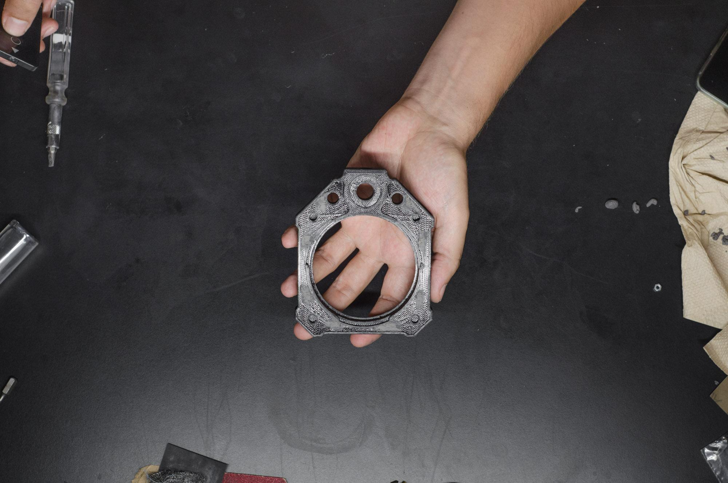
CLEANING AND SANDING
Clean the epoxy stains with a regular metal brush.

Slide 13
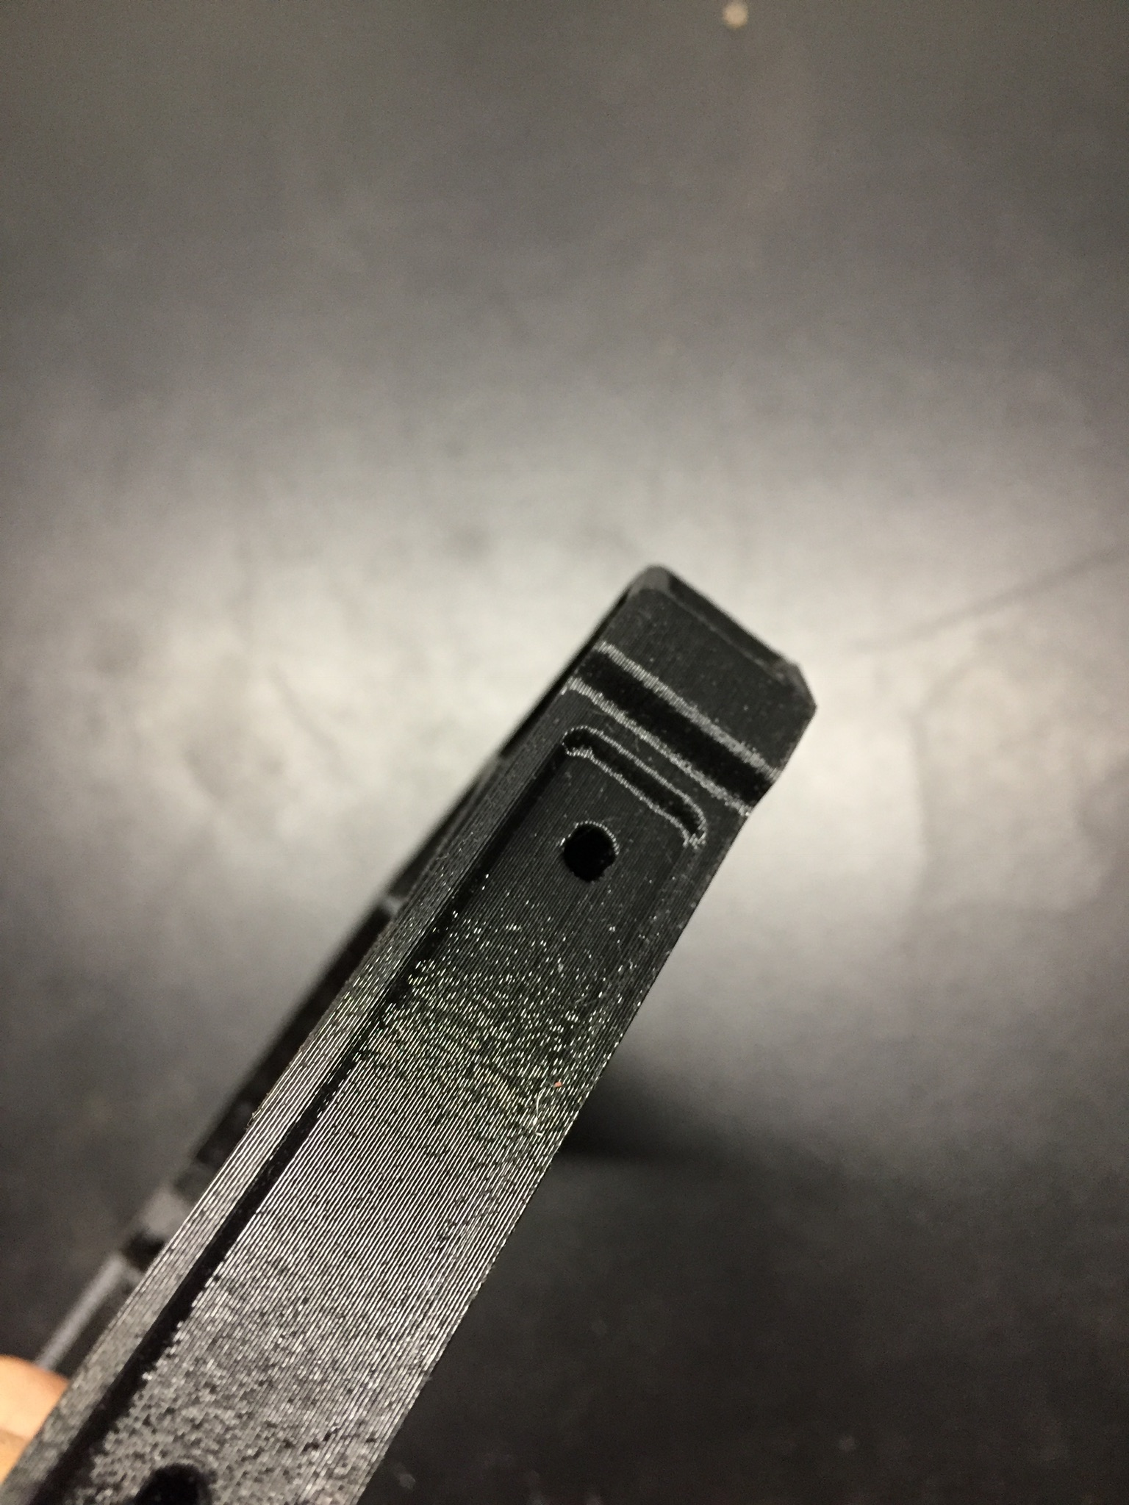
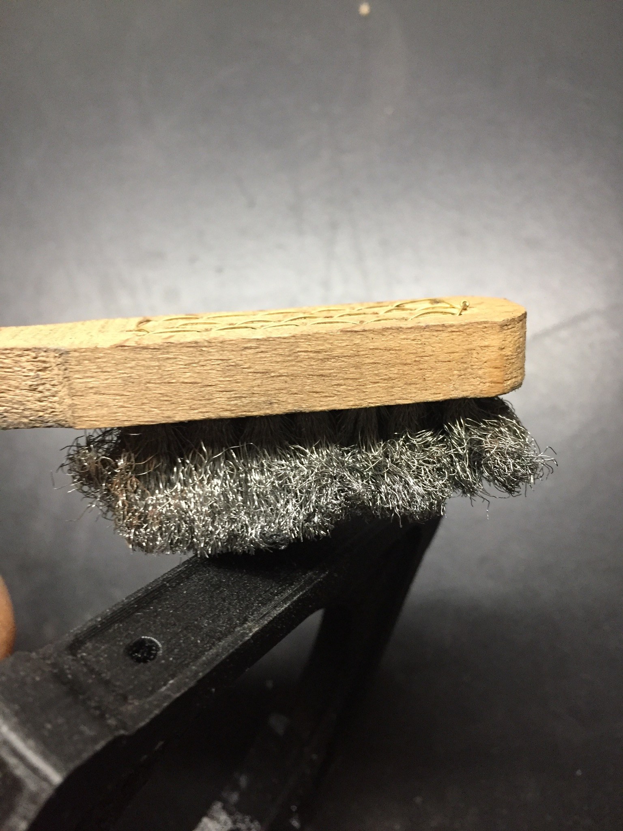
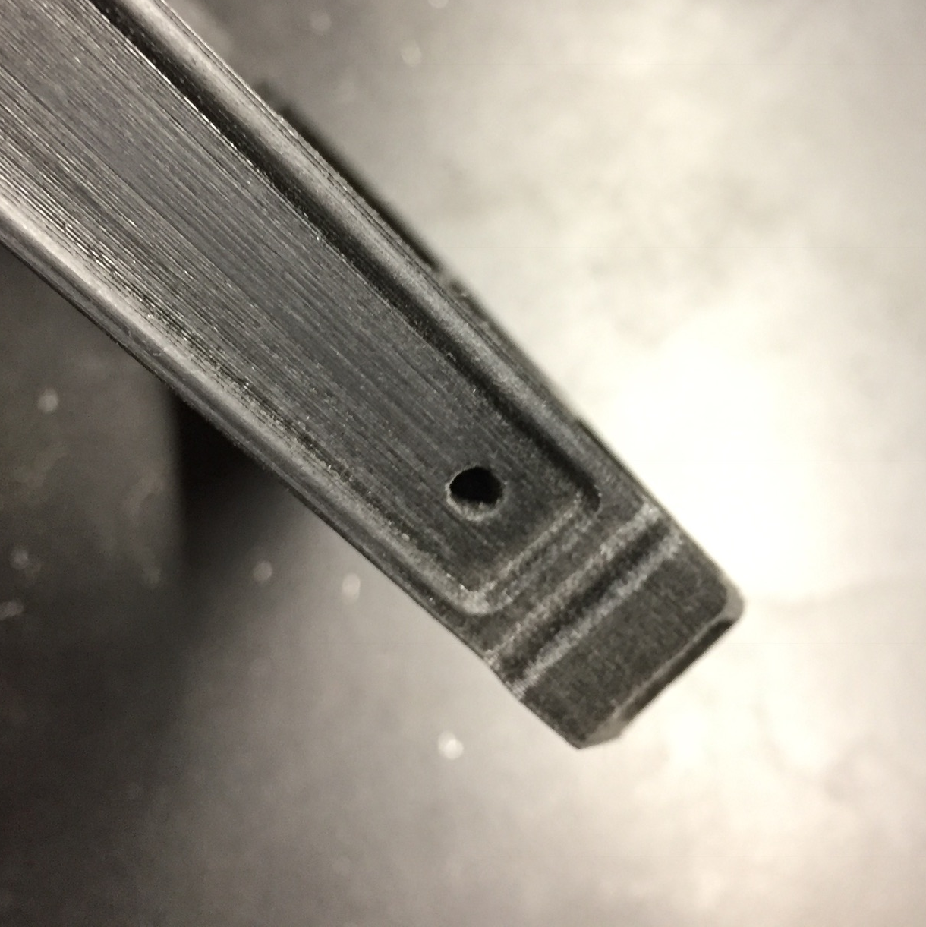
CLEANING AND SANDING
Normally the 3D print is too shiny, but using a metal brush you can add a nice matte finish to the side of your camera part.

Slide 14
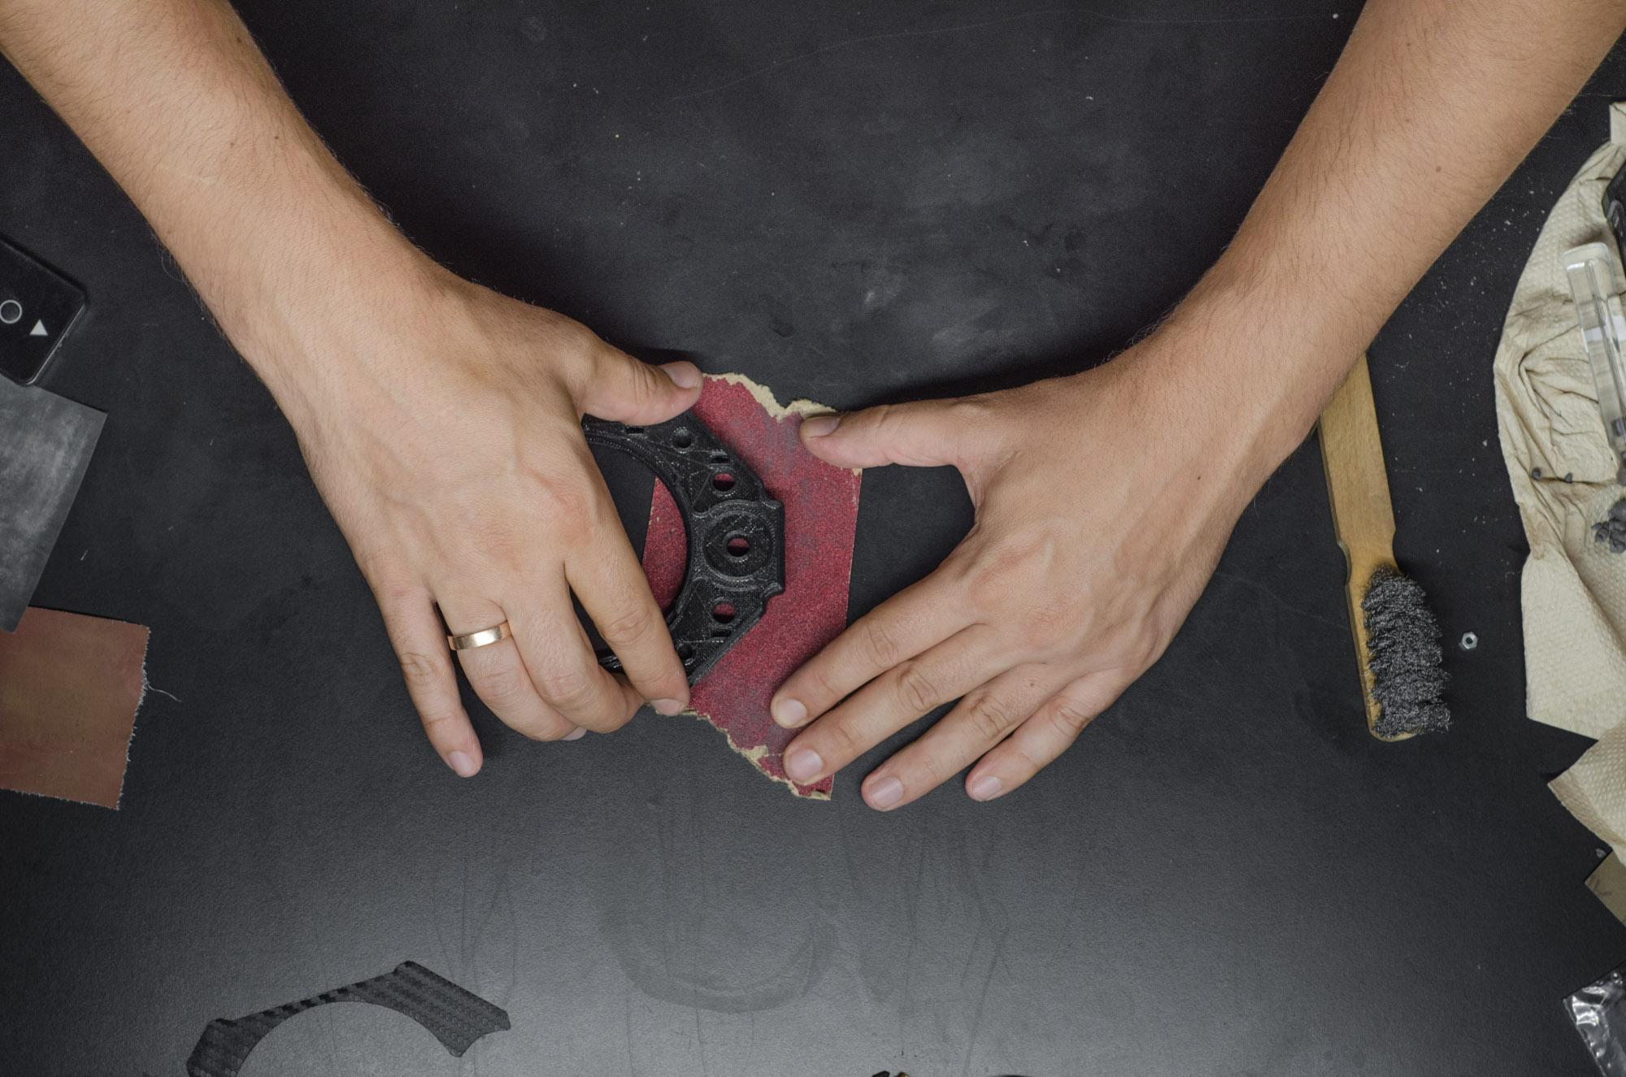
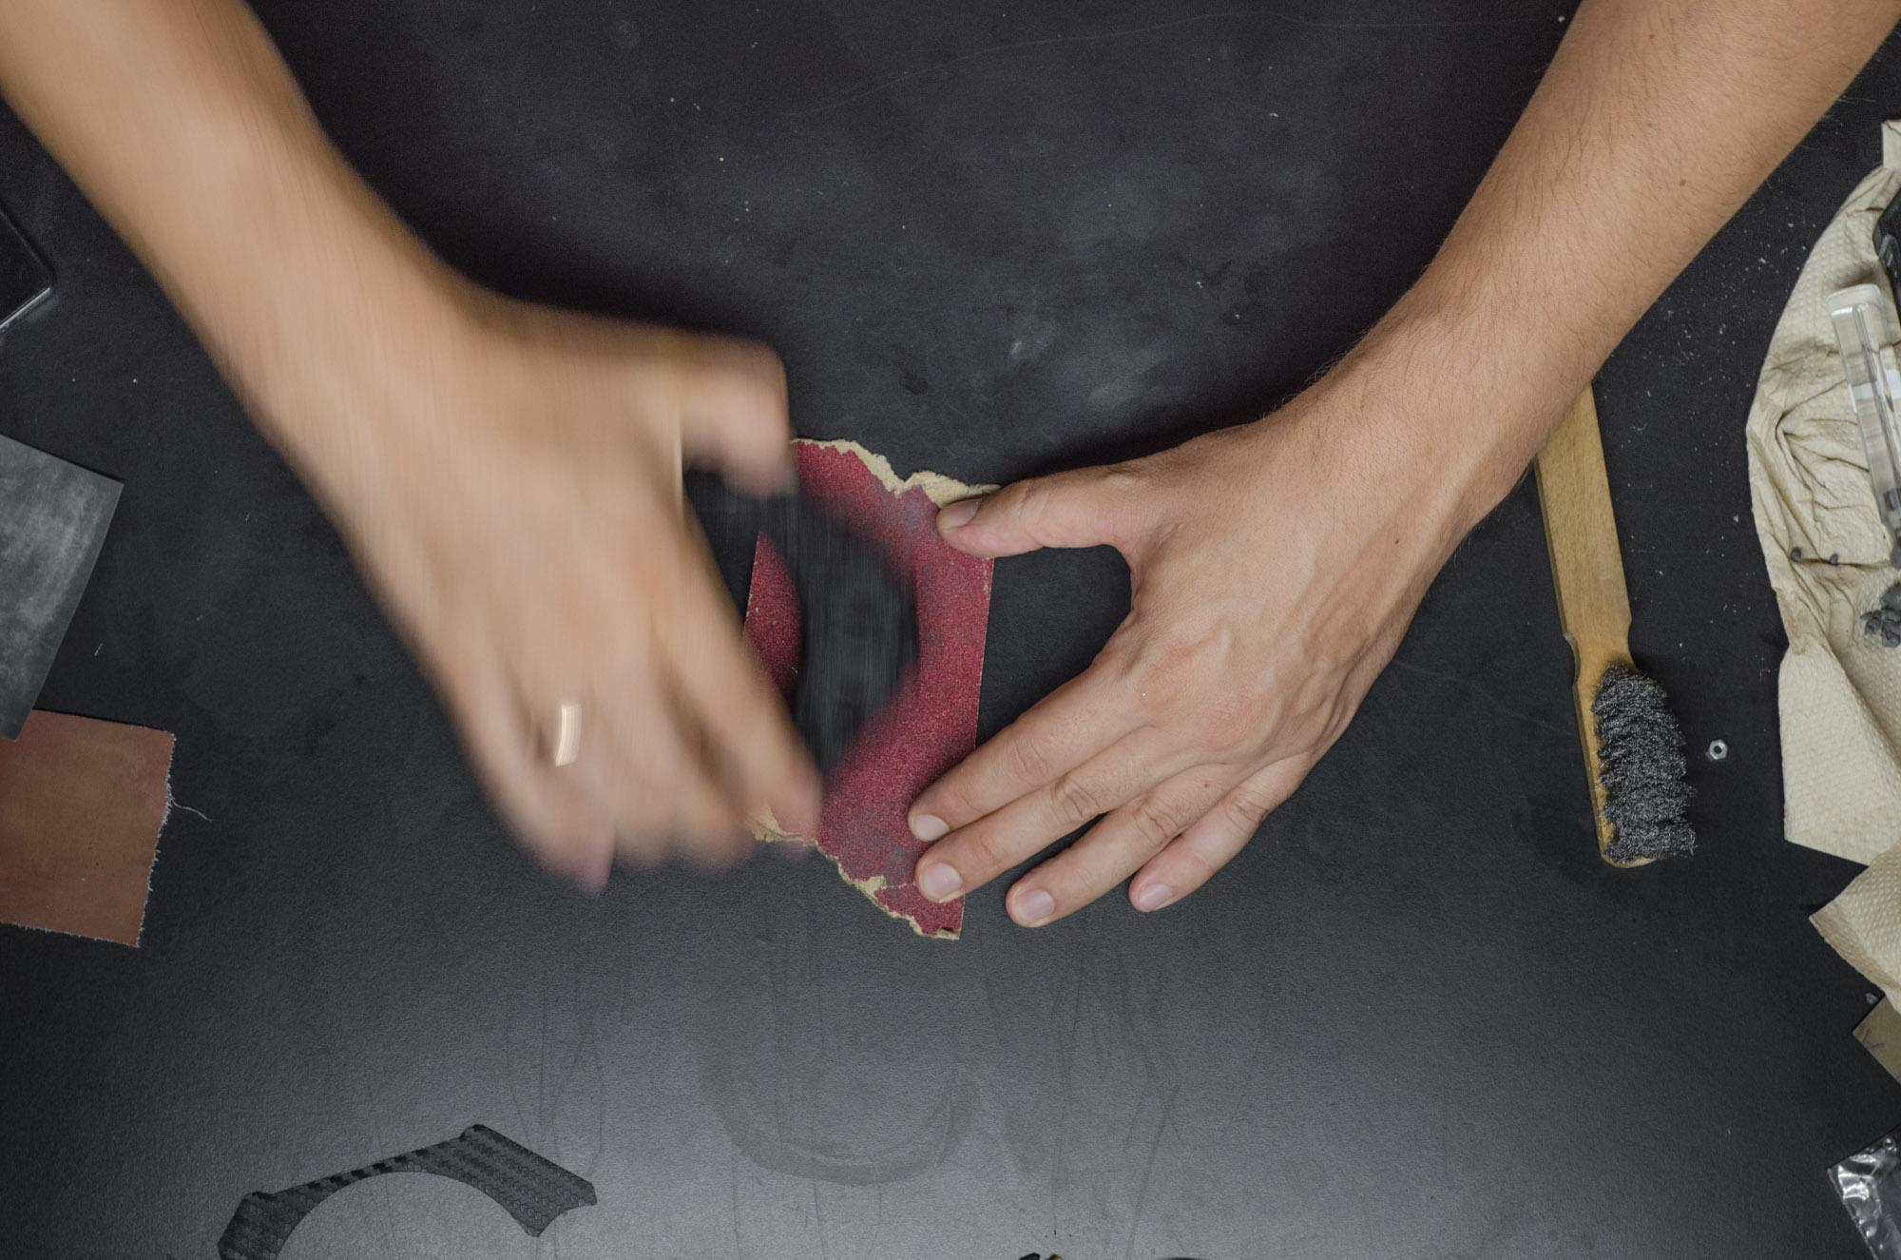
CLEANING AND SANDING
Start with a 100 micron sandpaper on the top and bottom of your 3D printed part.
Put the sandpaper on a flat surface end move the 3D printed part evenly.

Slide 15
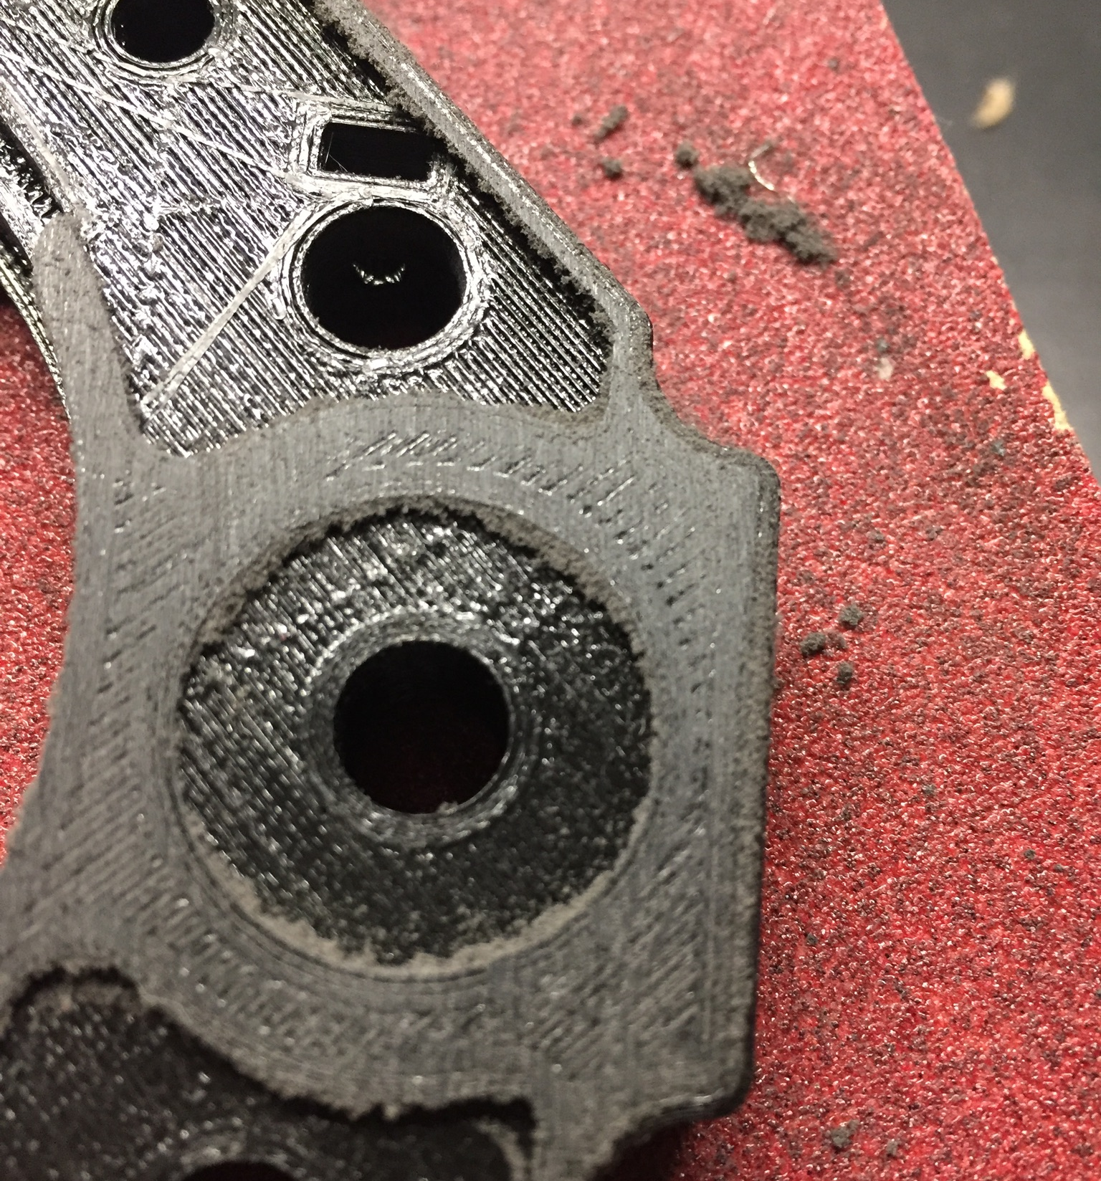
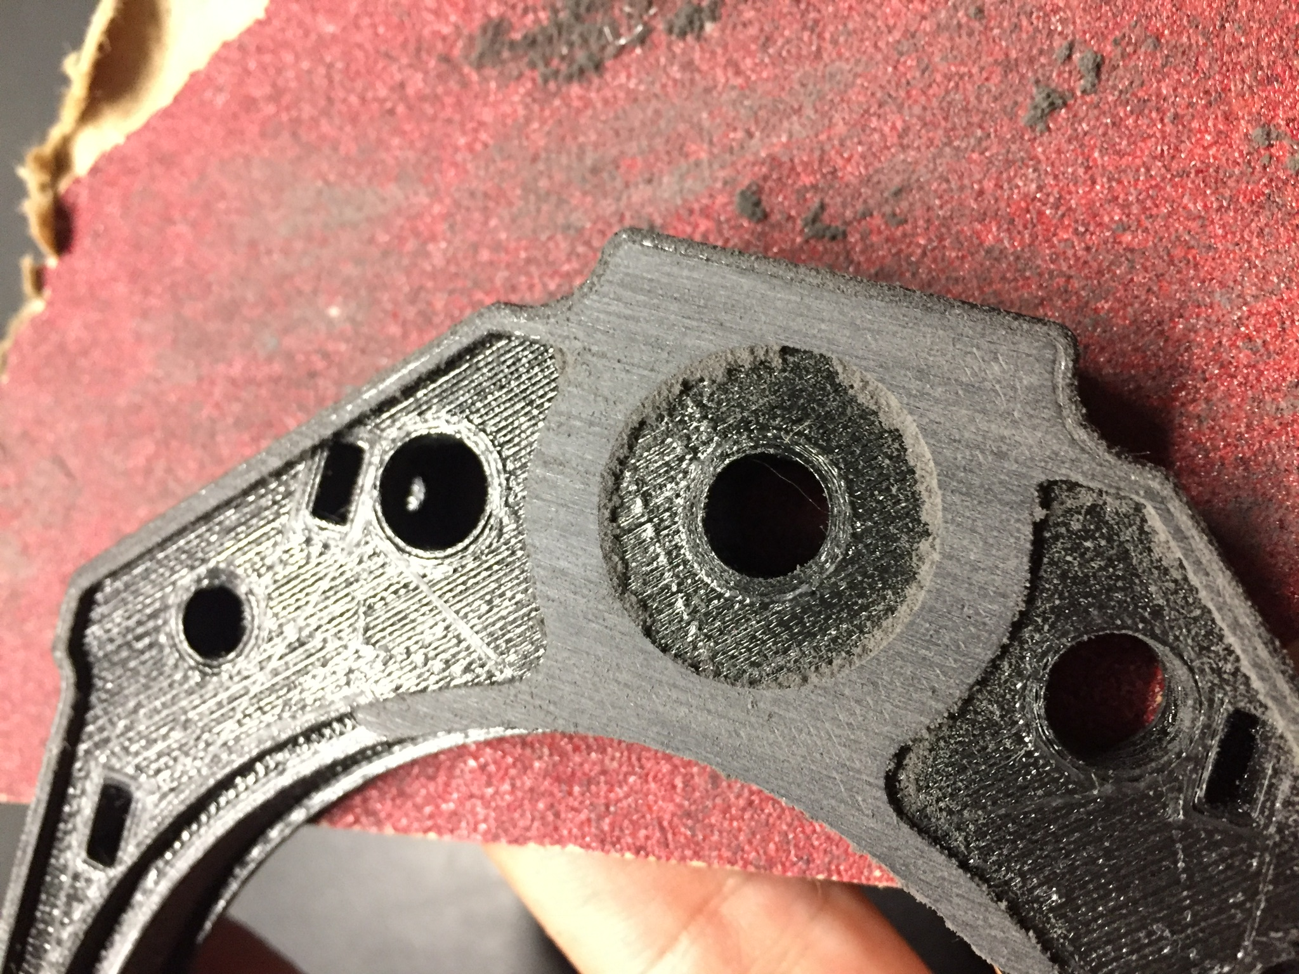
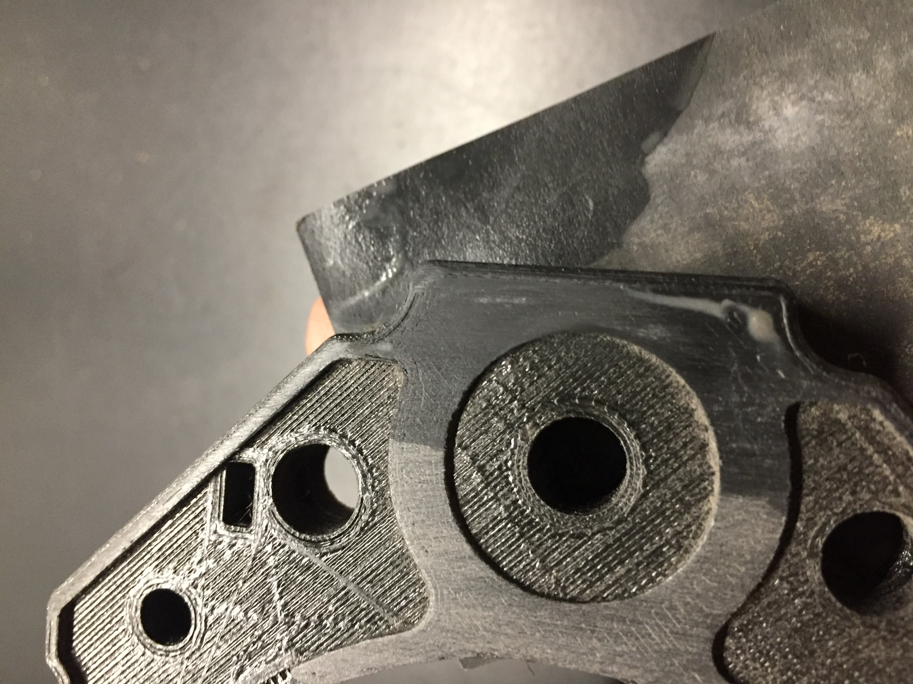
CLEANING AND SANDING
Use sandpaper from 100 microns to at least 800 microns. I only use sandpaper in the top and the bottom of my prints. I recommend to use metal brush/sponge on the side.

Slide 16
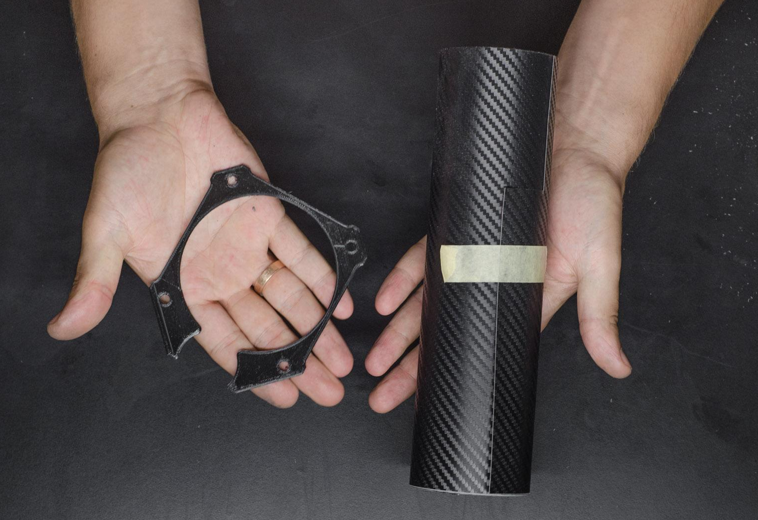
FRONT COVER
Use your 3D printed front cover part as a stencil to cut out your decoration foil or you can sand and clean the part flat and use it as it is. You can also cut out wooden veneer using the part, but it definitely needs more time and patience. Trust me :)

Slide 17
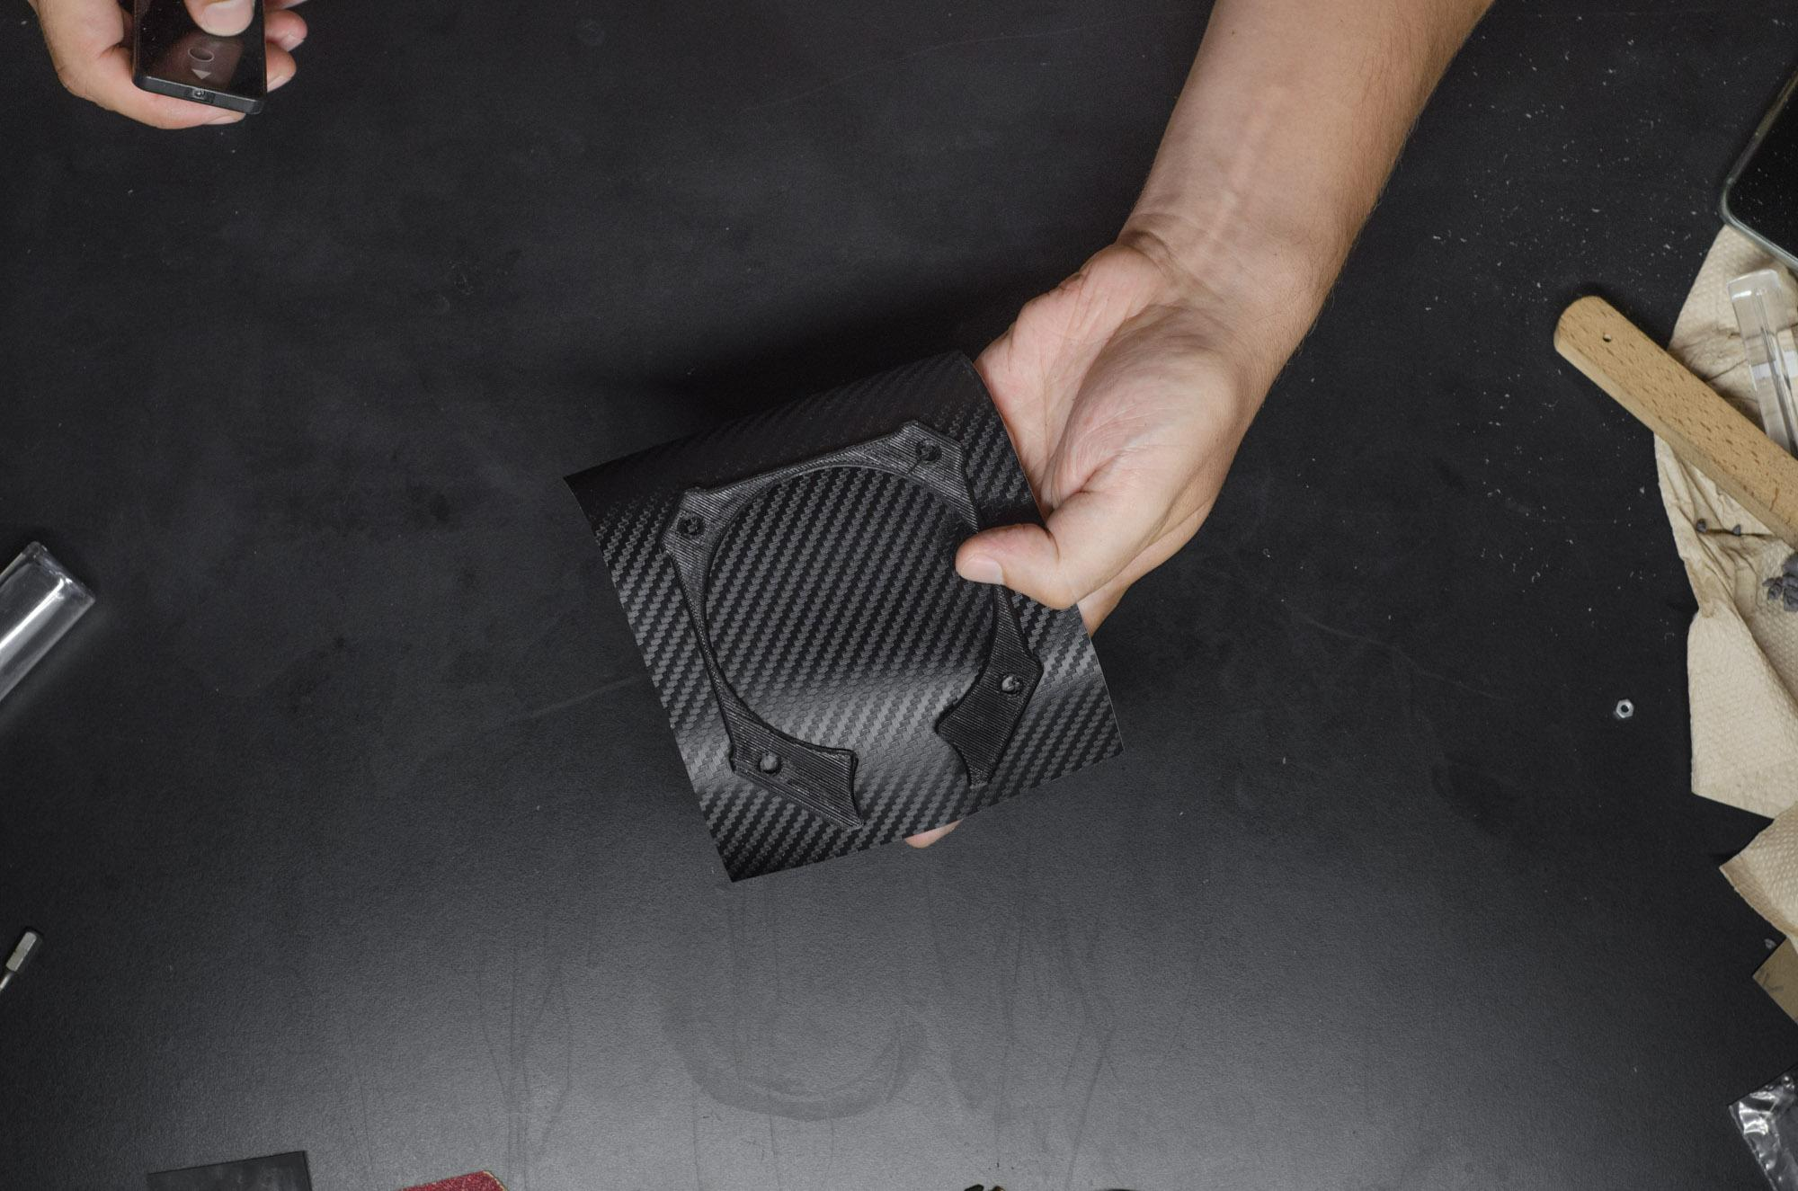
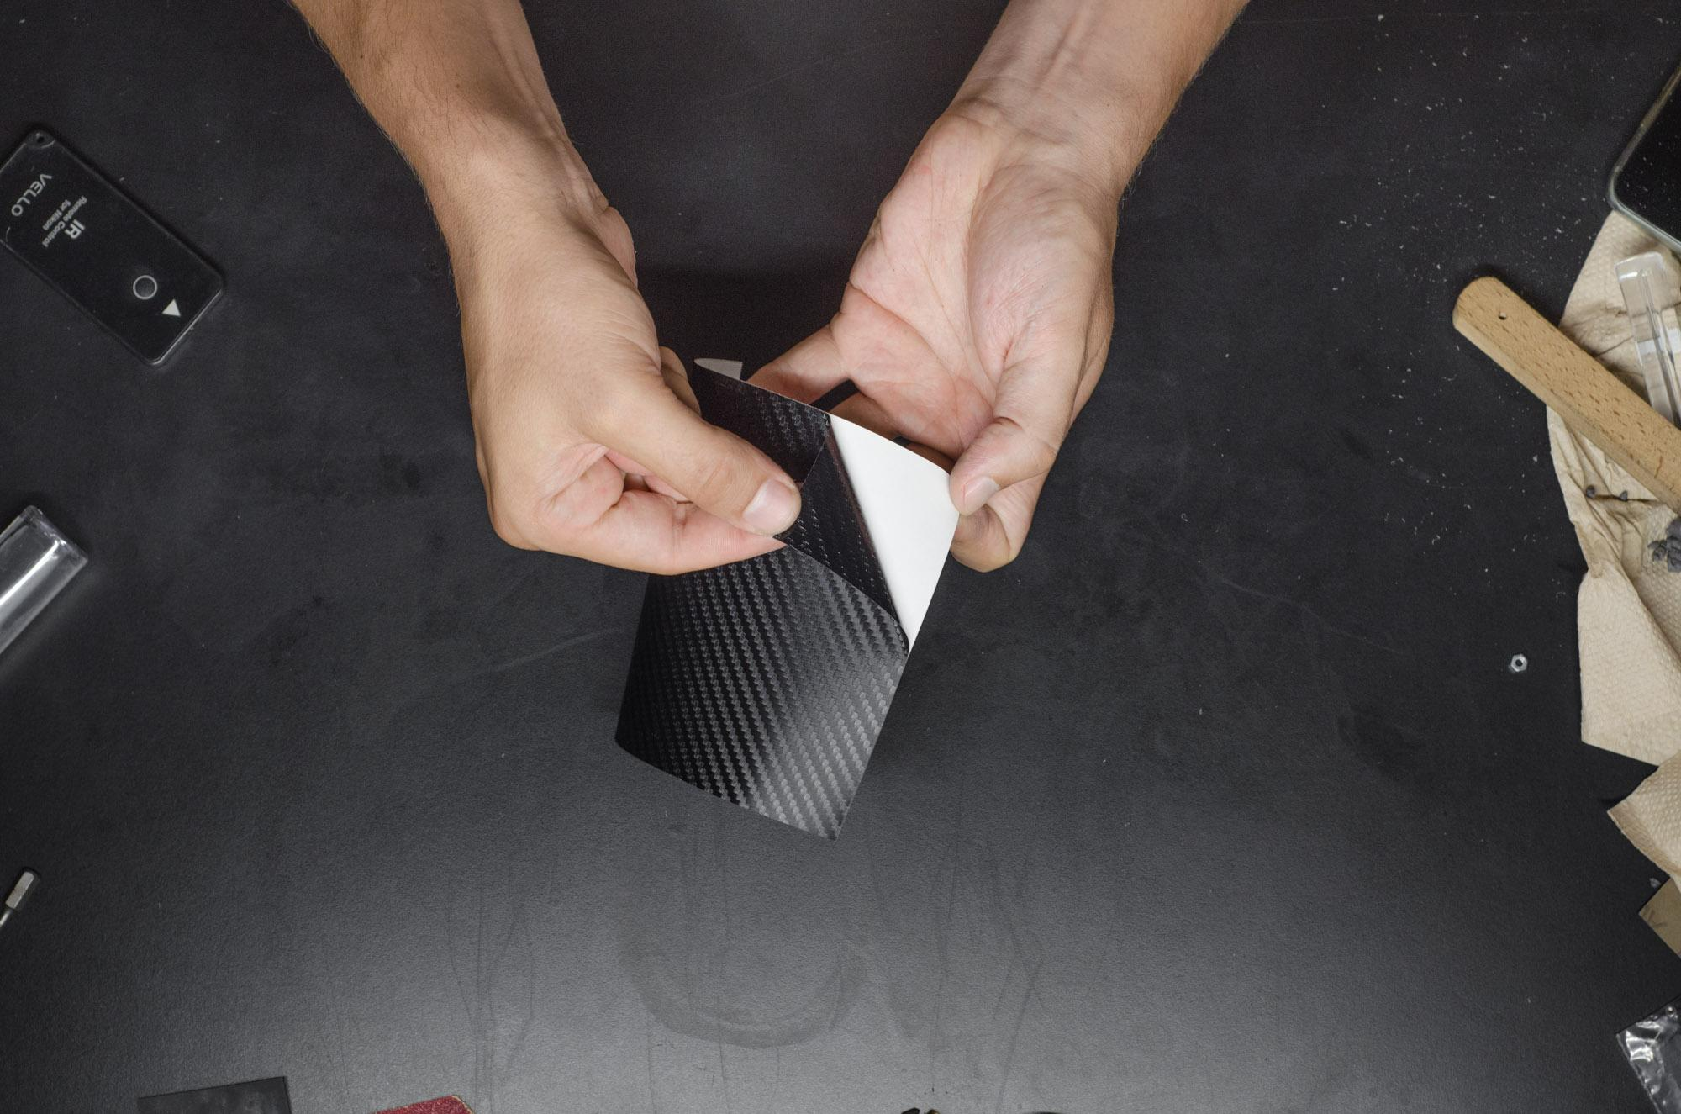
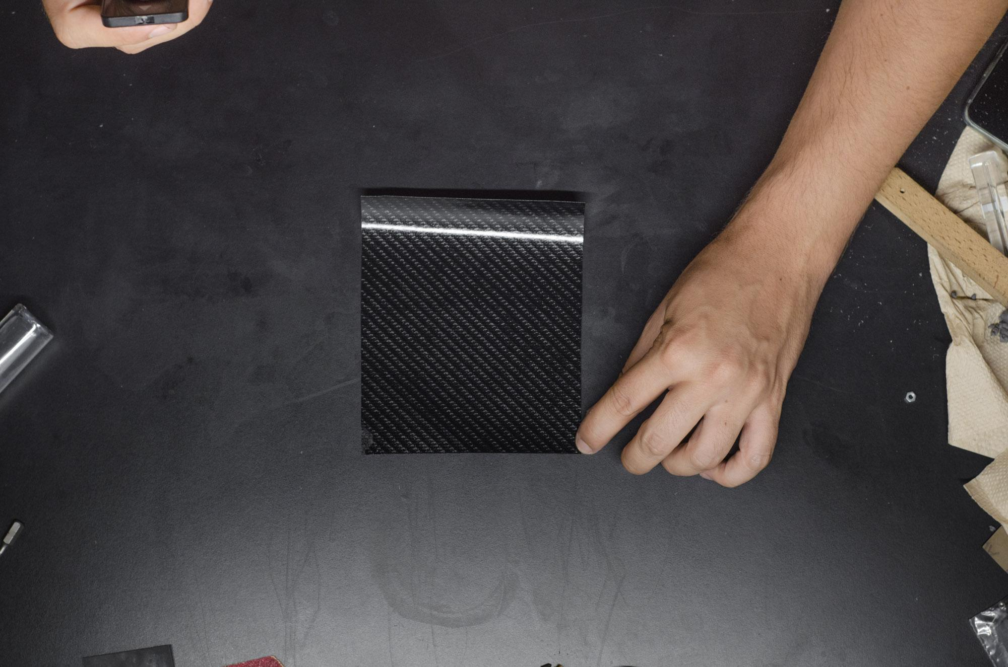
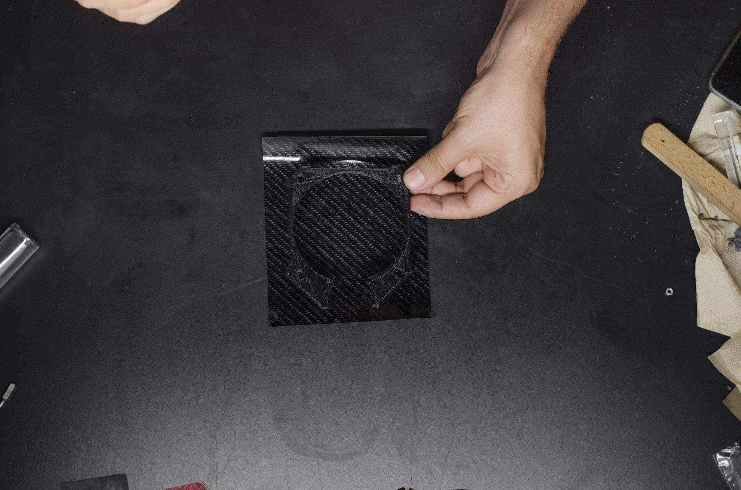
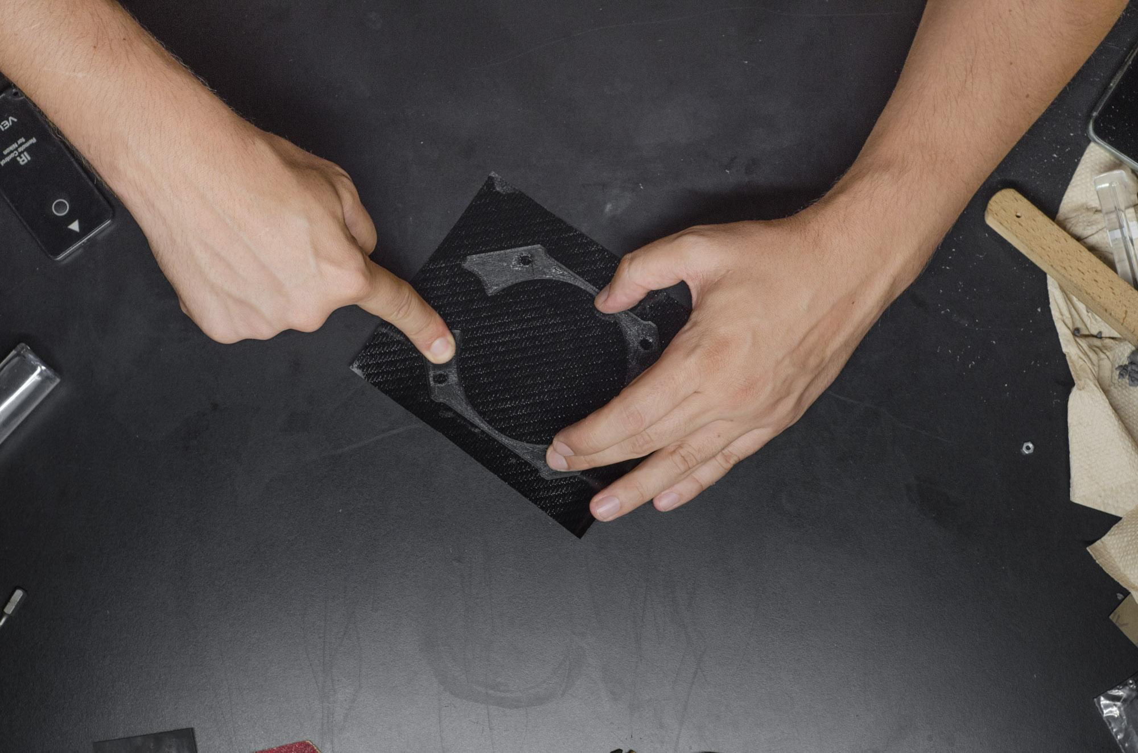
FRONT COVER
1.Cut out a slightly larger piece of foil then the printed part.
2.Put the foil on a flat surface - sticky side up.
3.Carefully place the printed part on the sticky foil.
4.Use your finger to make sure the foil is stuck on the print evenly without any bubbles.

Slide 18
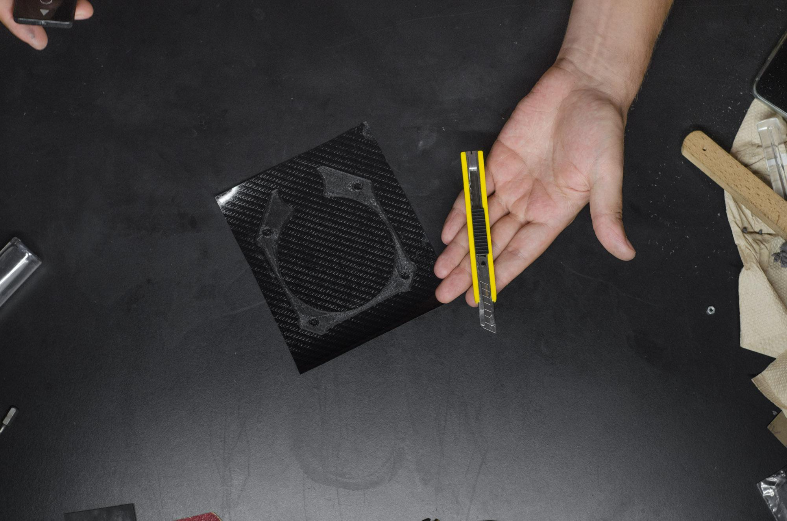
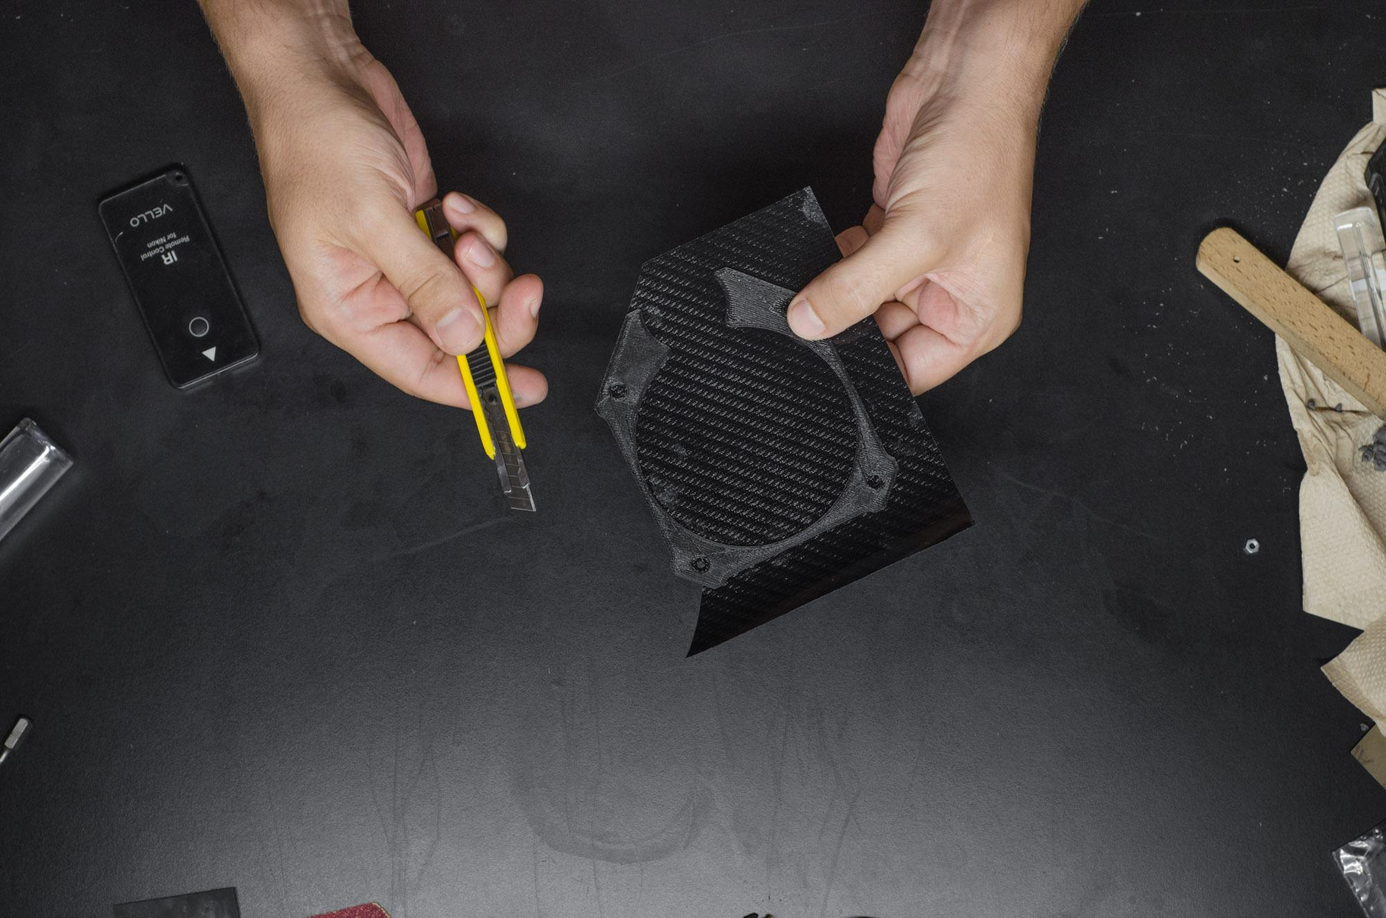

FRONT COVER
Cut out the foil using the edge of the printed part as a guide with a regular stencil knife.
(If you want to cut a wooden veneer you should get a professional stencil knife.)

Slide 19



FRONT COVER
With a fast drying glue ( i recommend Loctite 60 sec glue ) carefully cover the part where the front Cover fits

Slide 20


FRONT COVER
Place the front cover on top of the body part
(it you build the BRASS version cut the holes on the foil)
Press the cover part till the glue cures.
(Change the position of your fingers to get the two elements to stuck evenly)

Slide 21


PLACE THE BRASS THREADED INSERTS - BRASS VERSION ONLY
Jump forward to the slide 25 to continue with the M3 version

Slide 22



PLACE THE BRASS THREADED INSERTS - BRASS VERSION ONLY
Jump forward to the slide 25 to continue with the M3 version
Drive the insert on a longer or larger M4 screw to protect your fingers from the heat.
( Wear heat resistant gloves!!! ) Put the insert directly into the candle flame for about 15-20 sec.

Slide 23




PLACE THE BRASS THREADED INSERTS - BRASS VERSION ONLY
Jump forward to the slide 25 to continue with the M3 version
Press the hot insert in one of the holes till it reaches the bottom. Place all the four insert in the FRONT part of the camera and two more in the BACK part. (if you “screwed up” and the insert is crooked or something is not right, you can heat up the insert using the screw in it - but be careful, don’t melt your printed part)

Slide 24


PLACE THE BRASS THREADED INSERTS - BRASS VERSION ONLY
Jump forward to the slide 25 to continue with the M3 version
Don’t forget the BACK part of the camera. There are two holes on the side where the inserts must be placed

Slide 25



THREAD and KNOB
After sanding and cleaning the parts, put some glue in the square shaped hole of the KNOB and put it on the THREAD (the way you see on the third image)
(Turn the knob a few times, just to be sure it isn’t stuck)

Slide 26


THREAD and KNOB
Put an ordinary O-ring on the knob to make the grip more comfortable.

Slide 27



THE “BELLOWS”

Slide 28




THE “BELLOWS”
(There are 4mm wide 3mm deep holes on the prints for neodinium magnets.)
But i recommend gluing the parts together:
“BELLOW MALE” to BODY FRONT PART
“BELLOW FEMALE” to
BODY BACK PART

Slide 29

THE “BELLOWS”
You can lock down the “bellows” with placing M3 screws and nuts.
If you don’t - just cover the holes from the inside.

Slide 30



SET SCREWS and ALU RODS
Install the set screws and the aluminium RODs. The tip of the set screw will hold the aluminium rod in its place.

Slide 31



1 / 4 ” to 3 / 8 ”
Drive a 1/4" to 3/8" Camera Convert Screw at the bottom of the FRONT part.
(You can add some glue to make it permanent.)

Slide 32
THANK YOU

